Slide 1
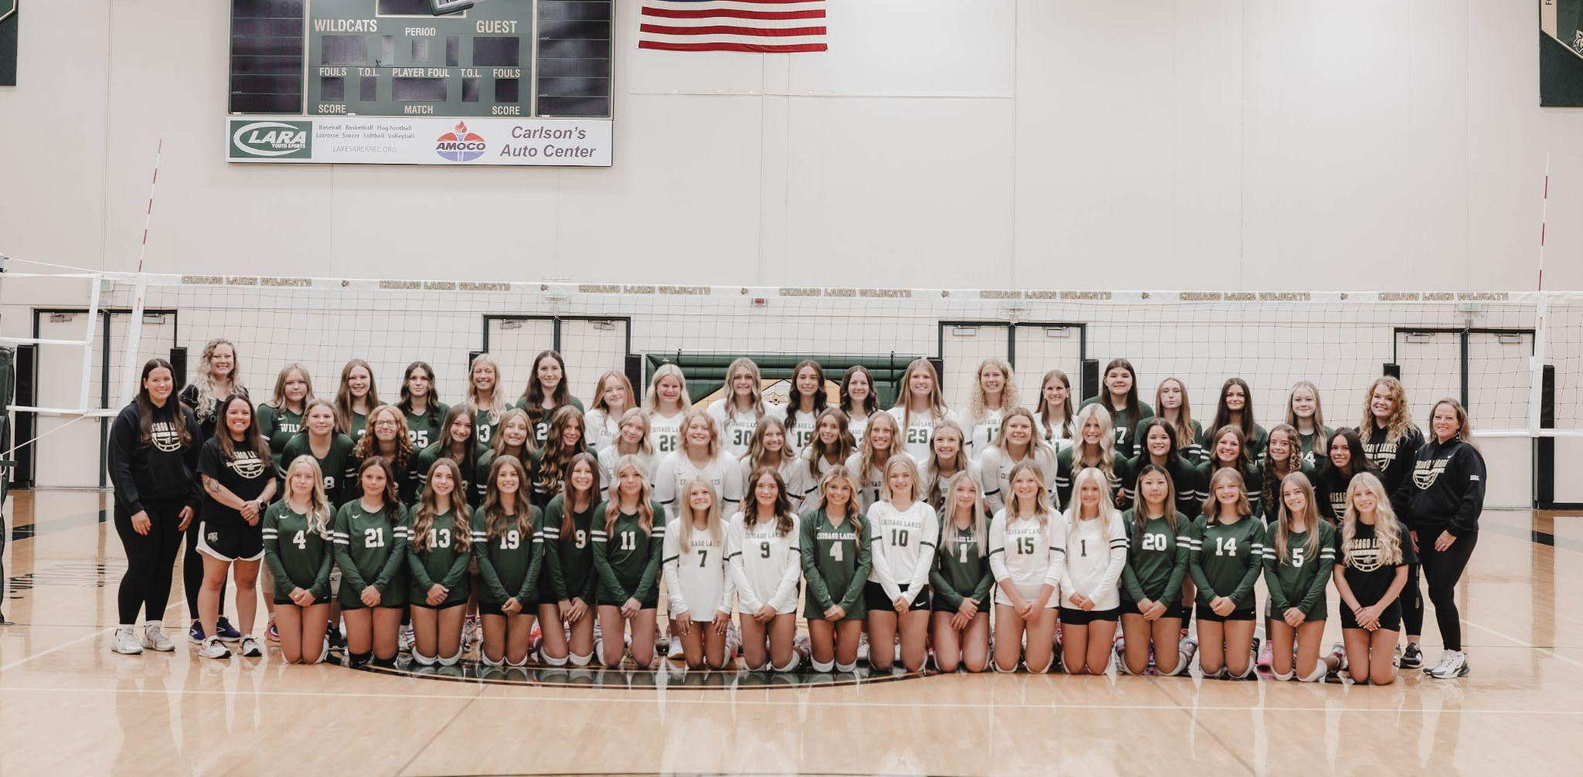
Welcome to the 2025
Chisago Lakes Volleyball Banquet!

Slide 2
Agenda
November 10, 2024 6:30pm at Lakes Free Church
Introduction & Season Highlights Coach Hannah
9th Grade Team Presentation & Awards Coach Katie
B-Squad Team Presentation & Awards Coach Avery
JV Team Presentation & Awards Coaches Vince & Nicole
Varsity Team Presentation & Awards Coach Hannah
Senior, Manager, Coach, & Parent Recognition Coach Hannah
Captain Presentation Team Captains
Conclusion Coach Hannah

Slide 3
Memories:
Bus rides
Being part of the program
Tournaments
Team dinners
Singing
Watching Varsity games
Cheering teammates on
Crazy plays
Friendships
Overcoming challenges
Seeing our improvement
Team bonding
FMSC
Playing against harder teams
The captains
Connections with the team
Gopher game
McDonalds and pumpkin painting
Summer practices
Buddy dodgeball
Gopher camp
Breakfast & coffee get togethers
Pre-game locker room dances
Urban Air

Slide 4
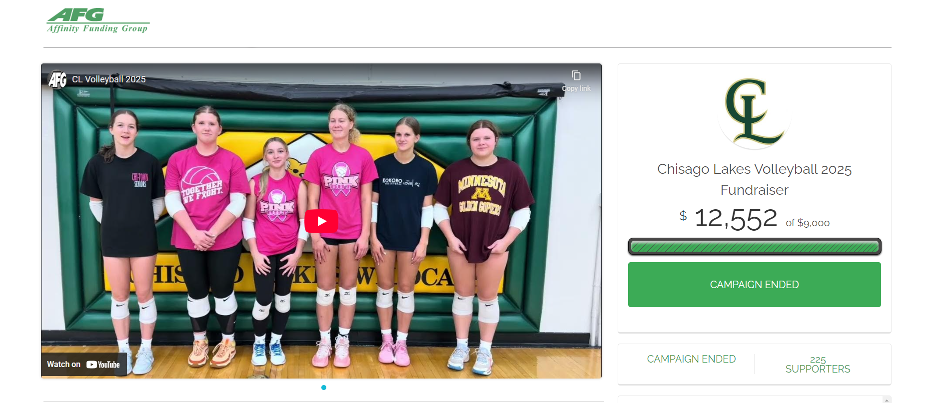
Fundraising

Slide 5

Hugh McCutcheon draws on his decades of high-level coaching (including Olympic gold) to propose that championship results come from championship behaviours. He argues that success is less about raw talent and more about how we learn, work, compete, lead and build culture.
Part I – Foundations
Championship Goal-Setting
Motivation, Motives, and Mindsets
Leadership
Work
Part II – Development
Research in Learning and Skill Development
The Championship Model for Skill Acquisition and Application
Part III – Achievement
Trust
Mentoring
Competitive Excellence
Culture
Mental, Physical, and Social Considerations
Conclusion: Operating at the Center
McCutcheon argues the goal is to operate “at the centre” — meaning to balance growth, performance, well-being, and sustain behaviours under pressure.
Encourages continual reflection, learning, and development beyond simply winning.

Slide 6
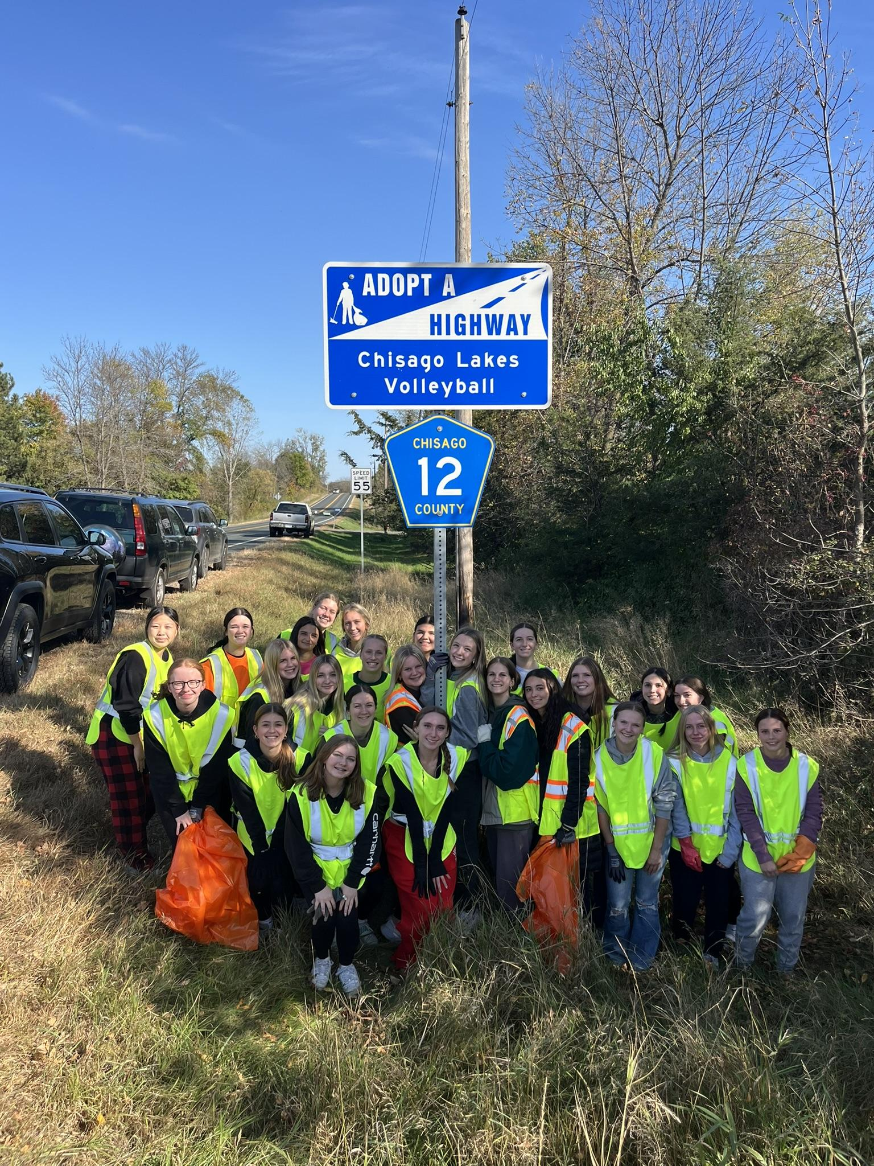
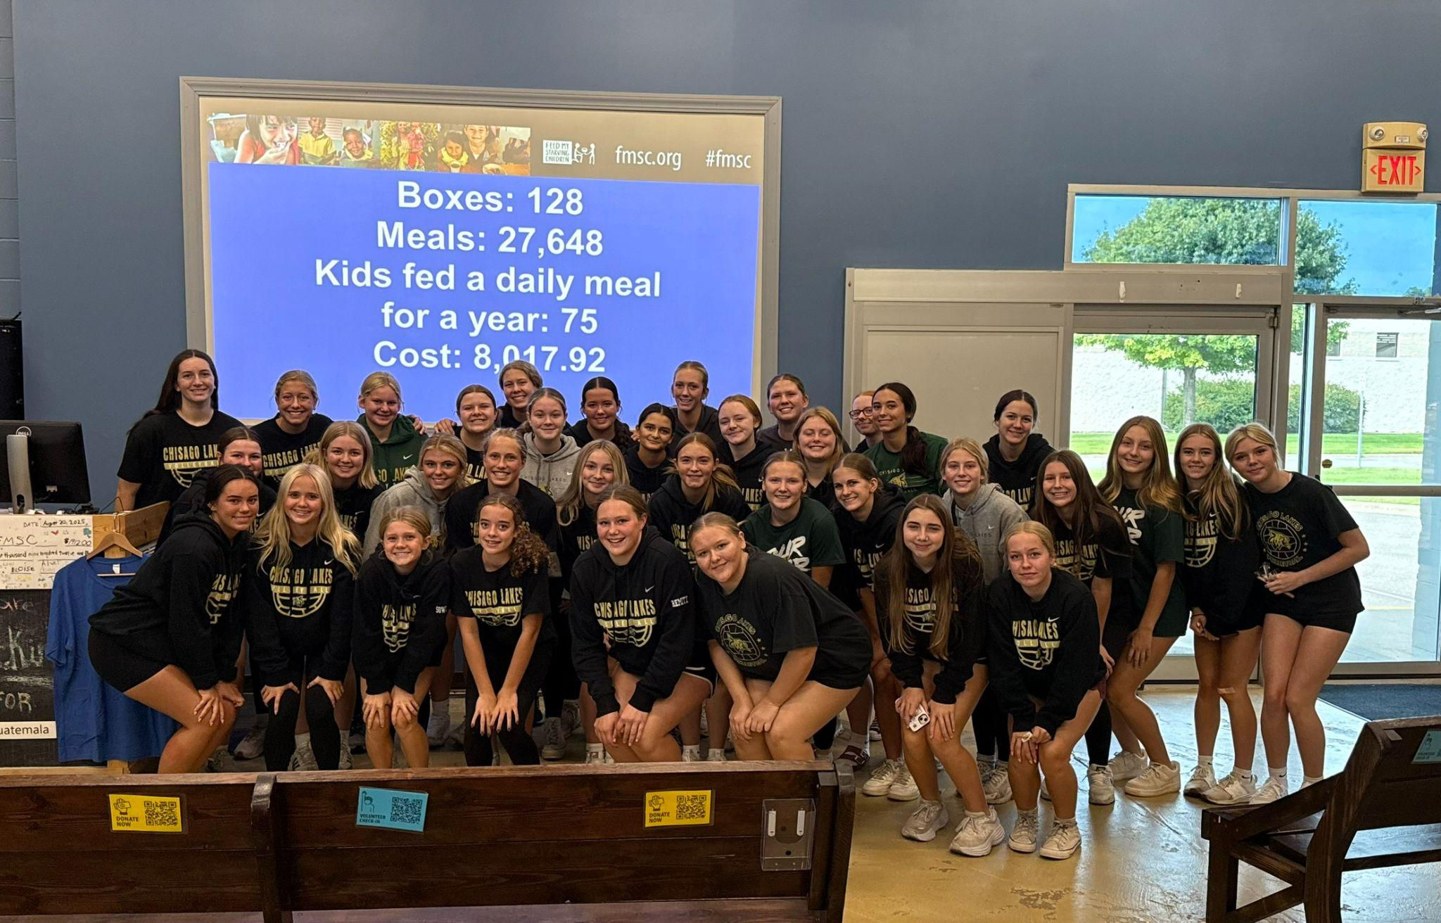
Community Service
Help us reach our goal of 750 hours!

Slide 7
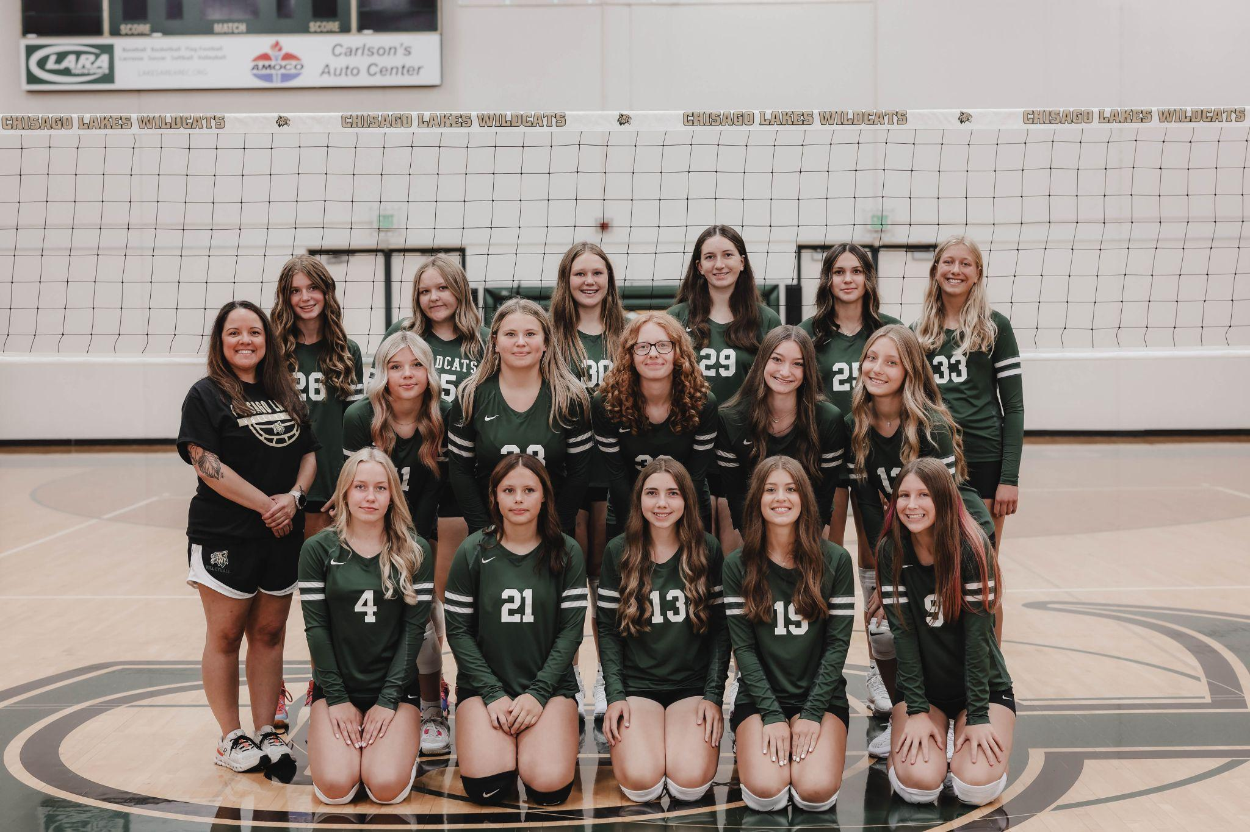
9th Grade Team

Slide 8
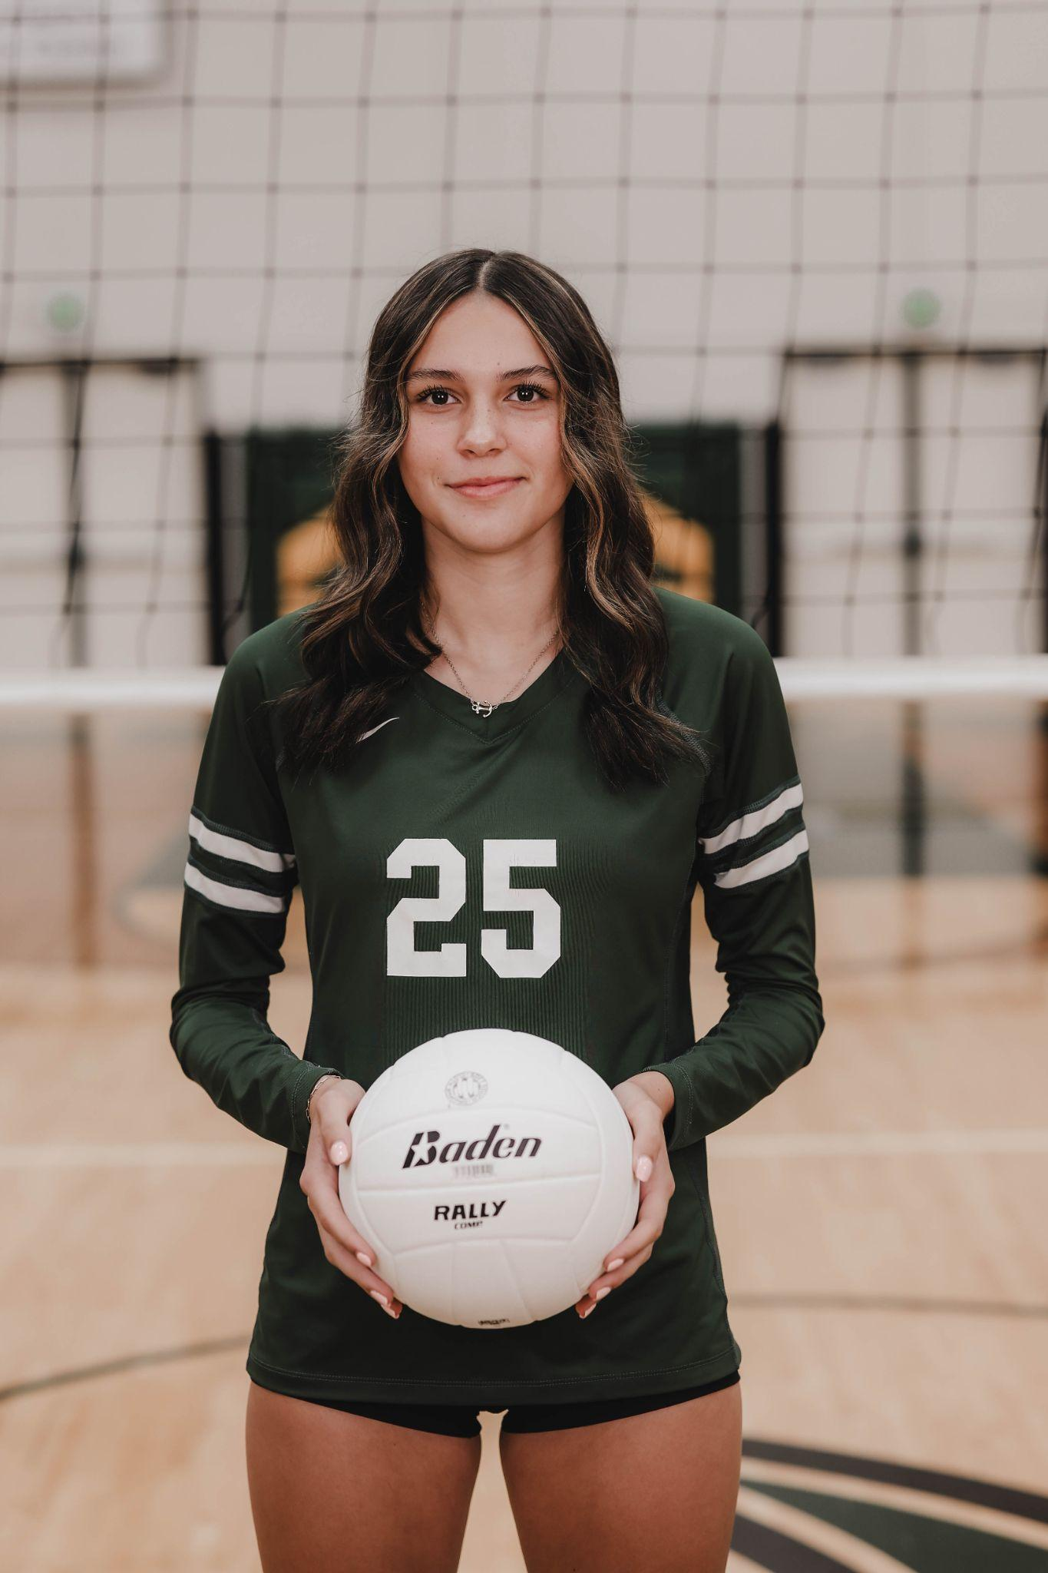
Best Offensive Player:
Rylie Williams

Slide 9
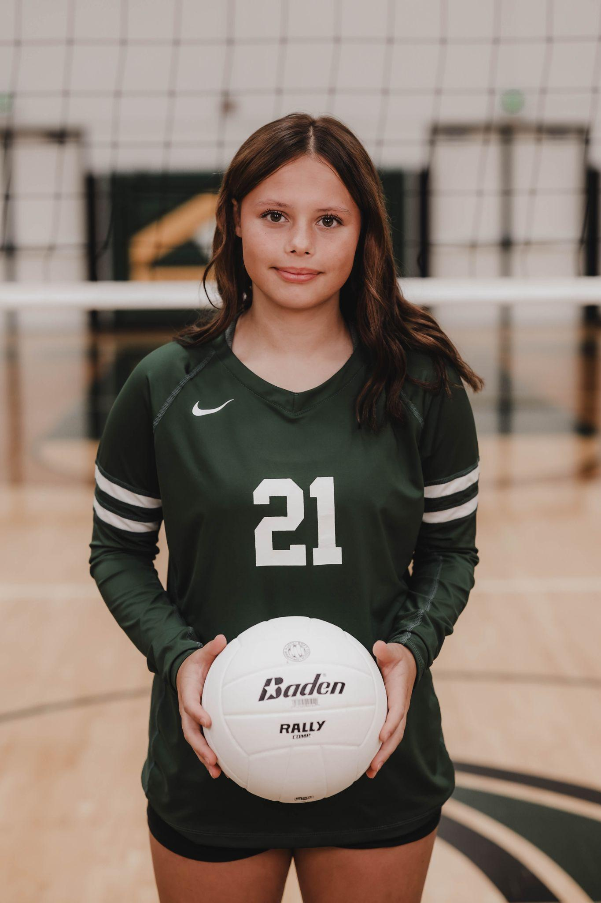
Best Defensive Player:
Zoey Stineman

Slide 10
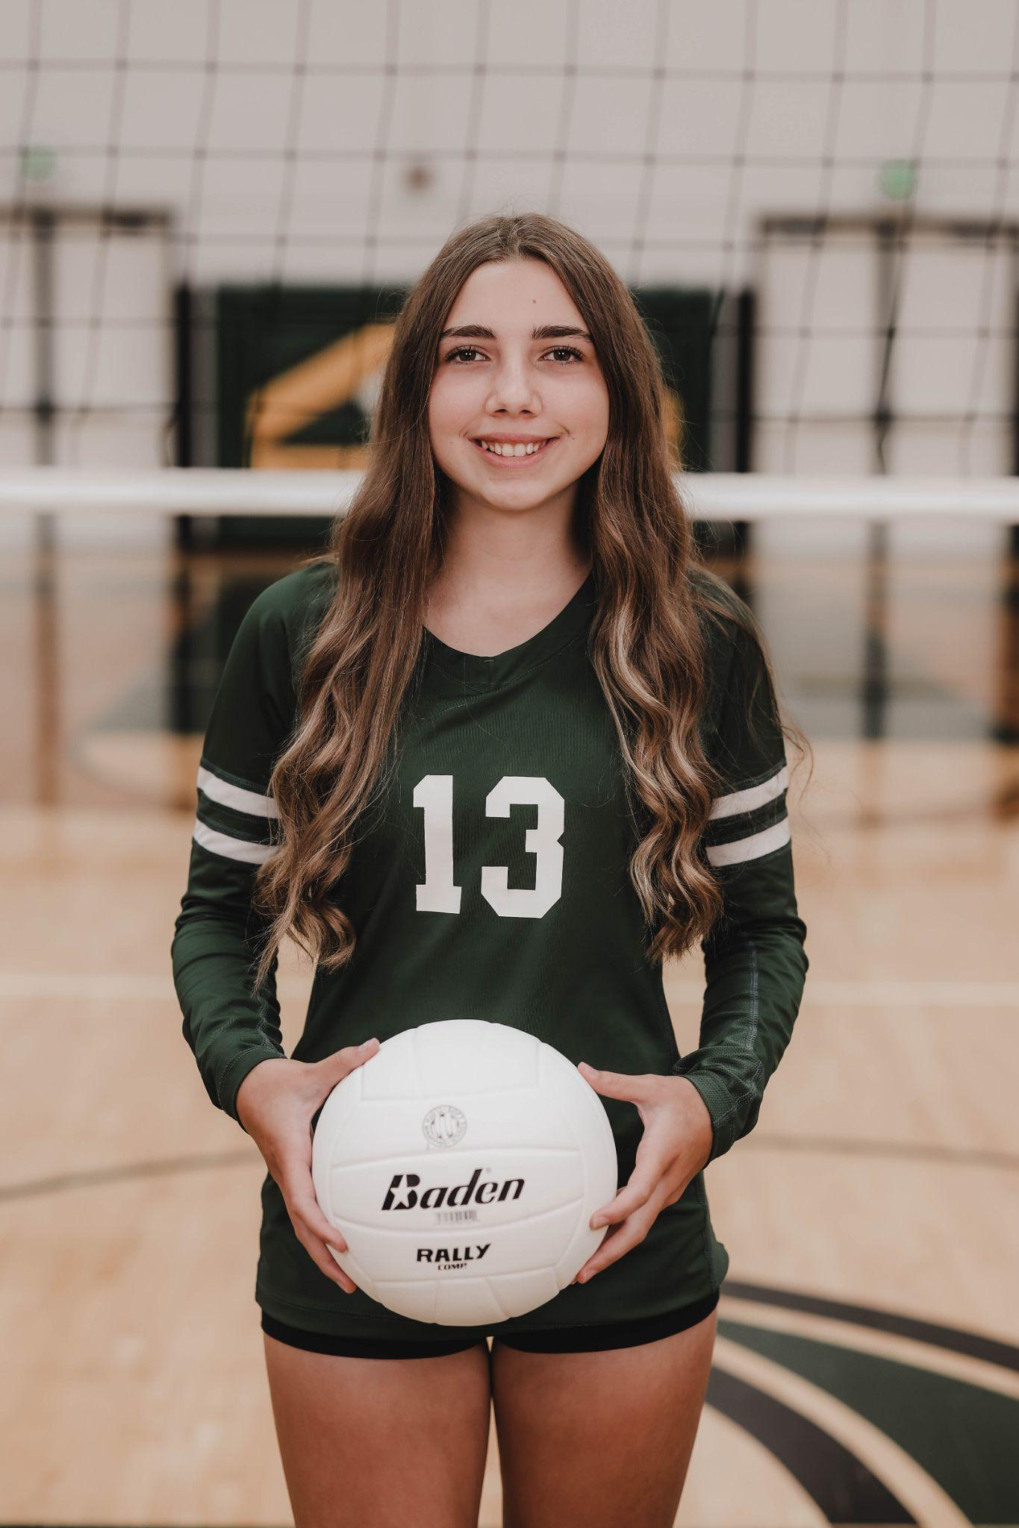
Most Valuable Player:
Illiana Duin

Slide 11
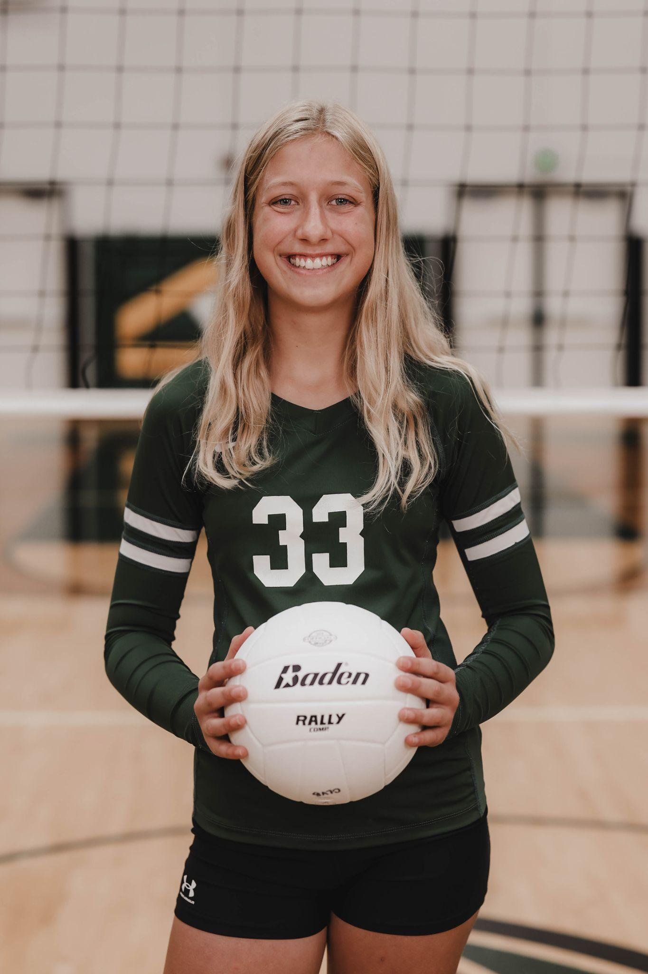
Wildcat Award:
Lily Cave

Slide 12
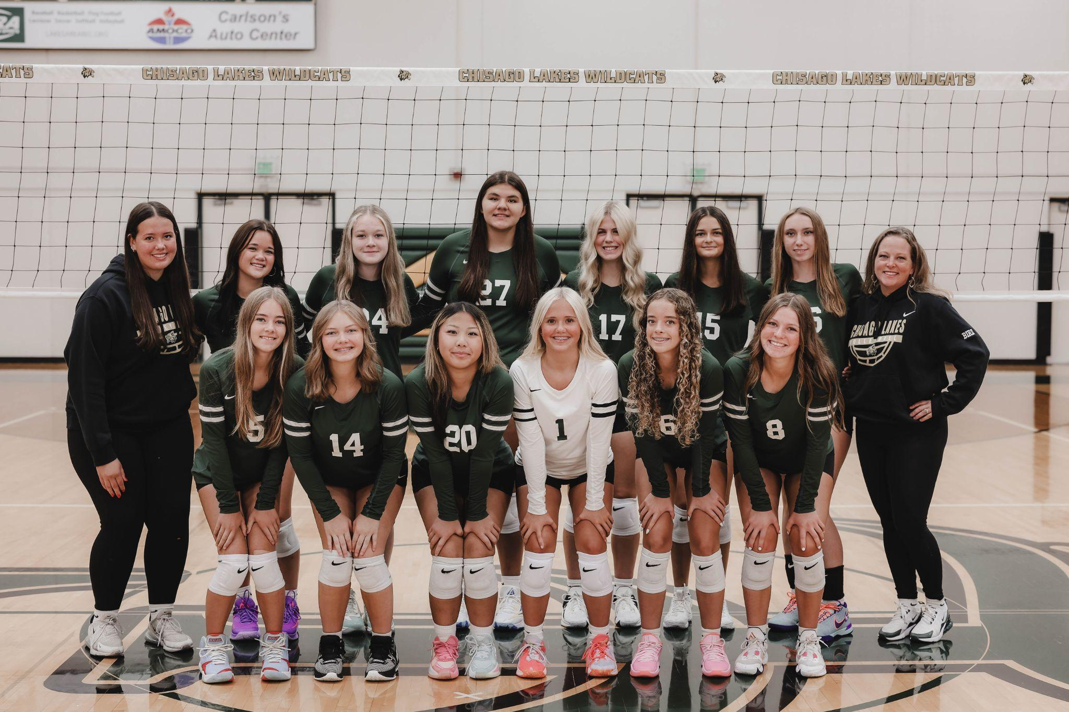
B-Squad Team

Slide 13
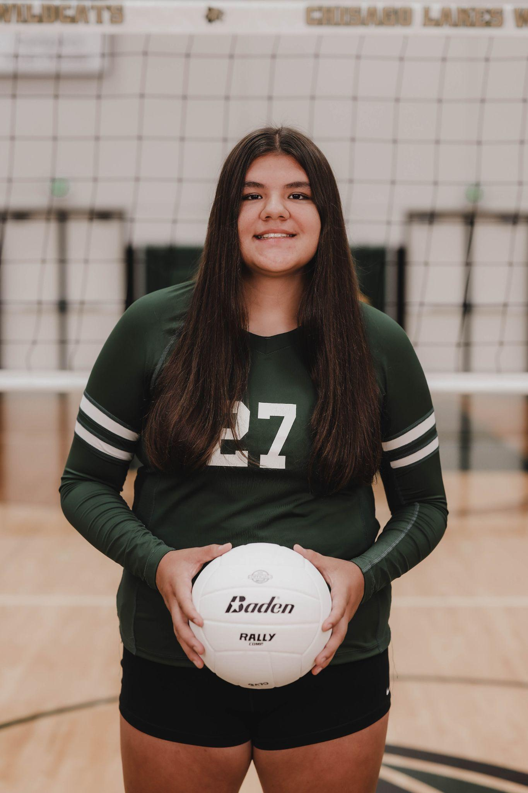
Best Offensive Player:
Mady Eagle

Slide 14
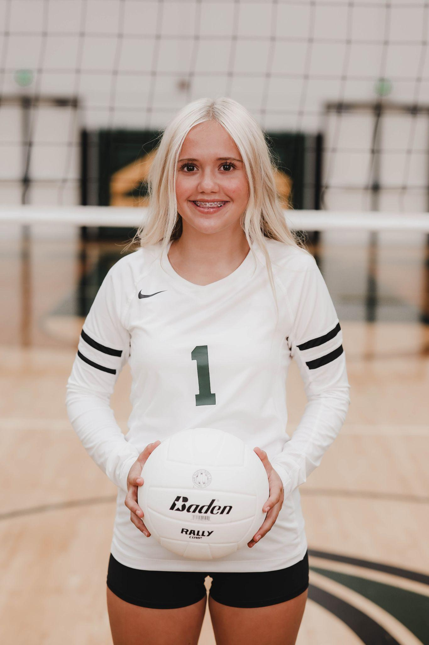
Best Defensive Player:
Claira Mattson

Slide 15
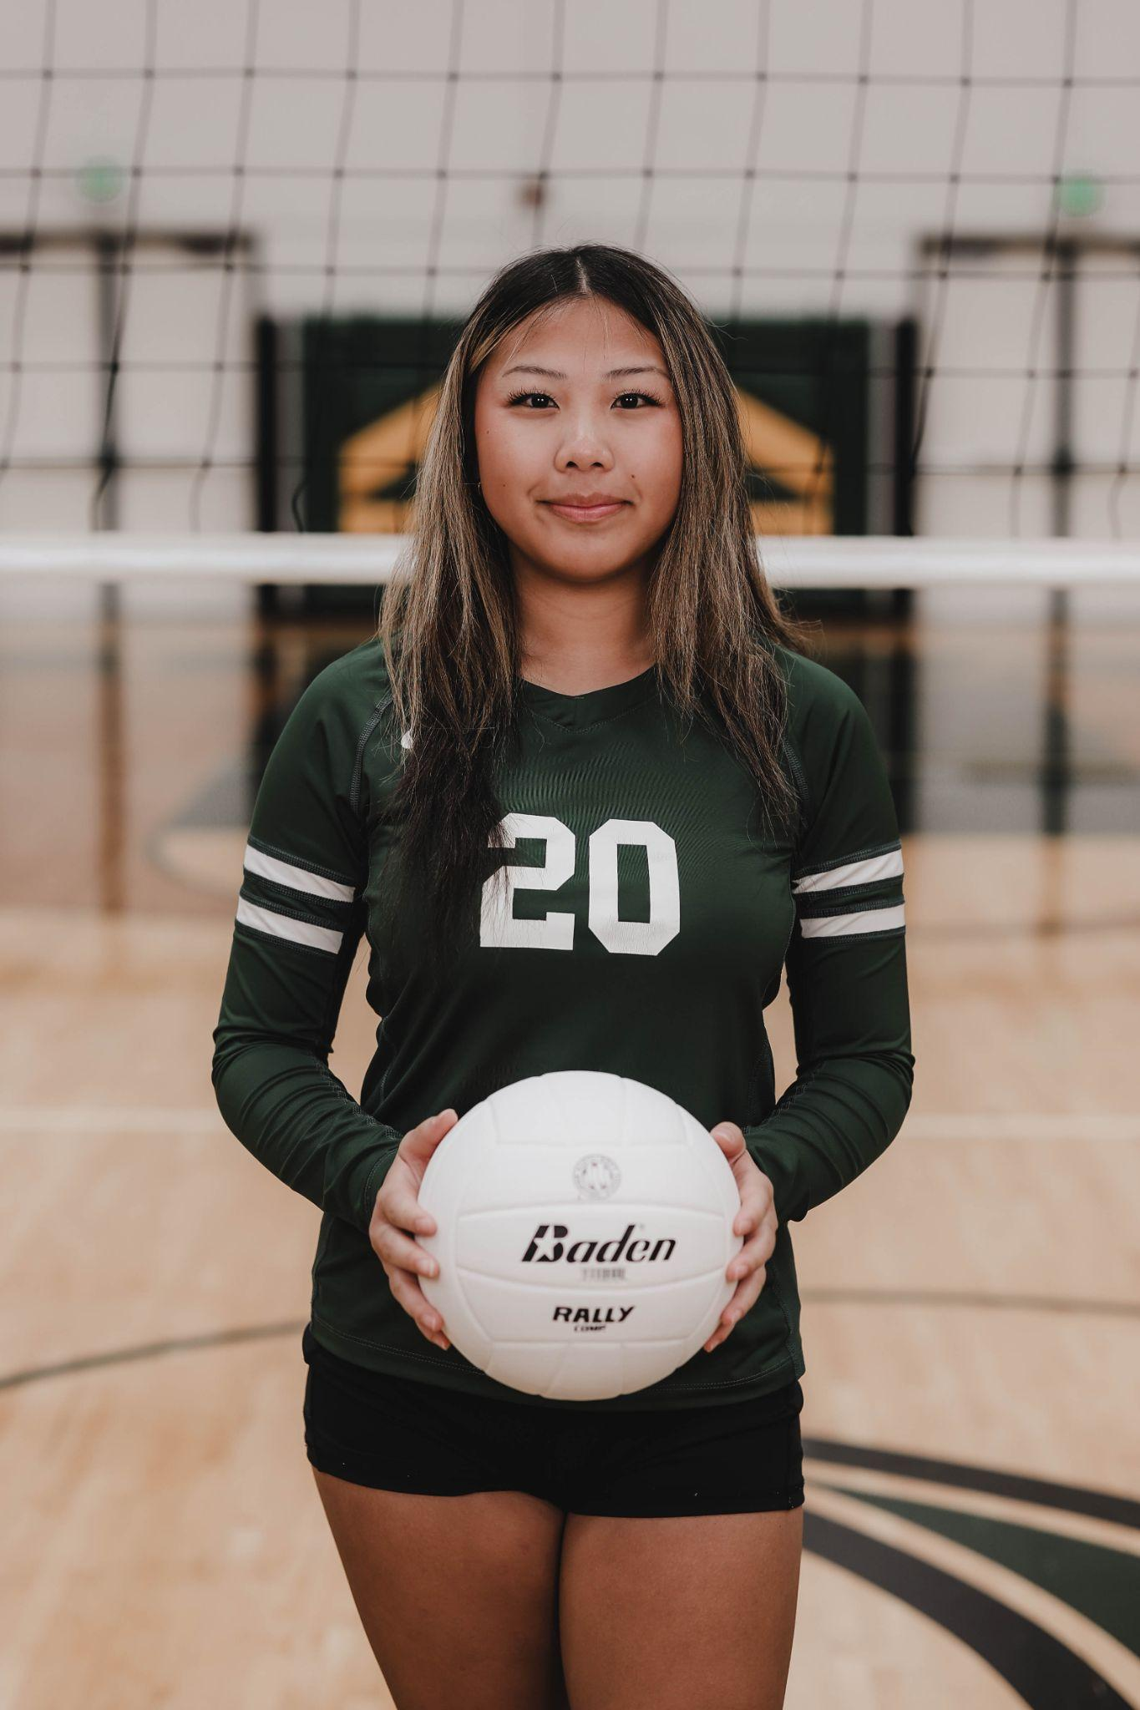
Most Valuable Player:
Corrina Yang

Slide 16
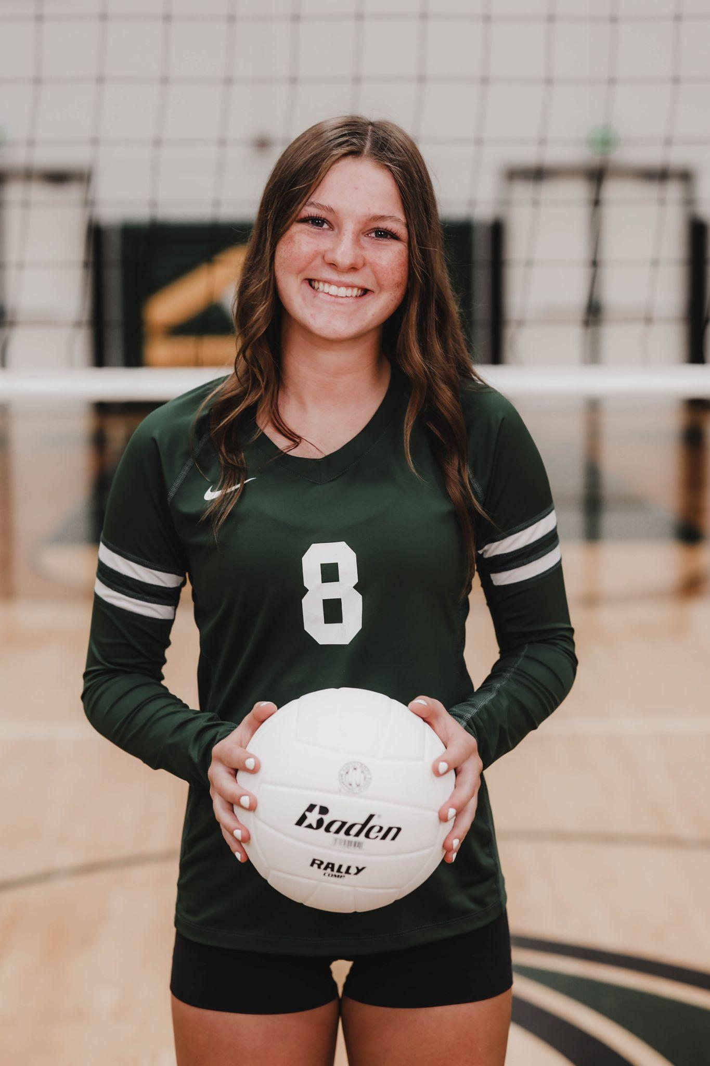
Wildcat Award:
Lulu Leritz

Slide 17
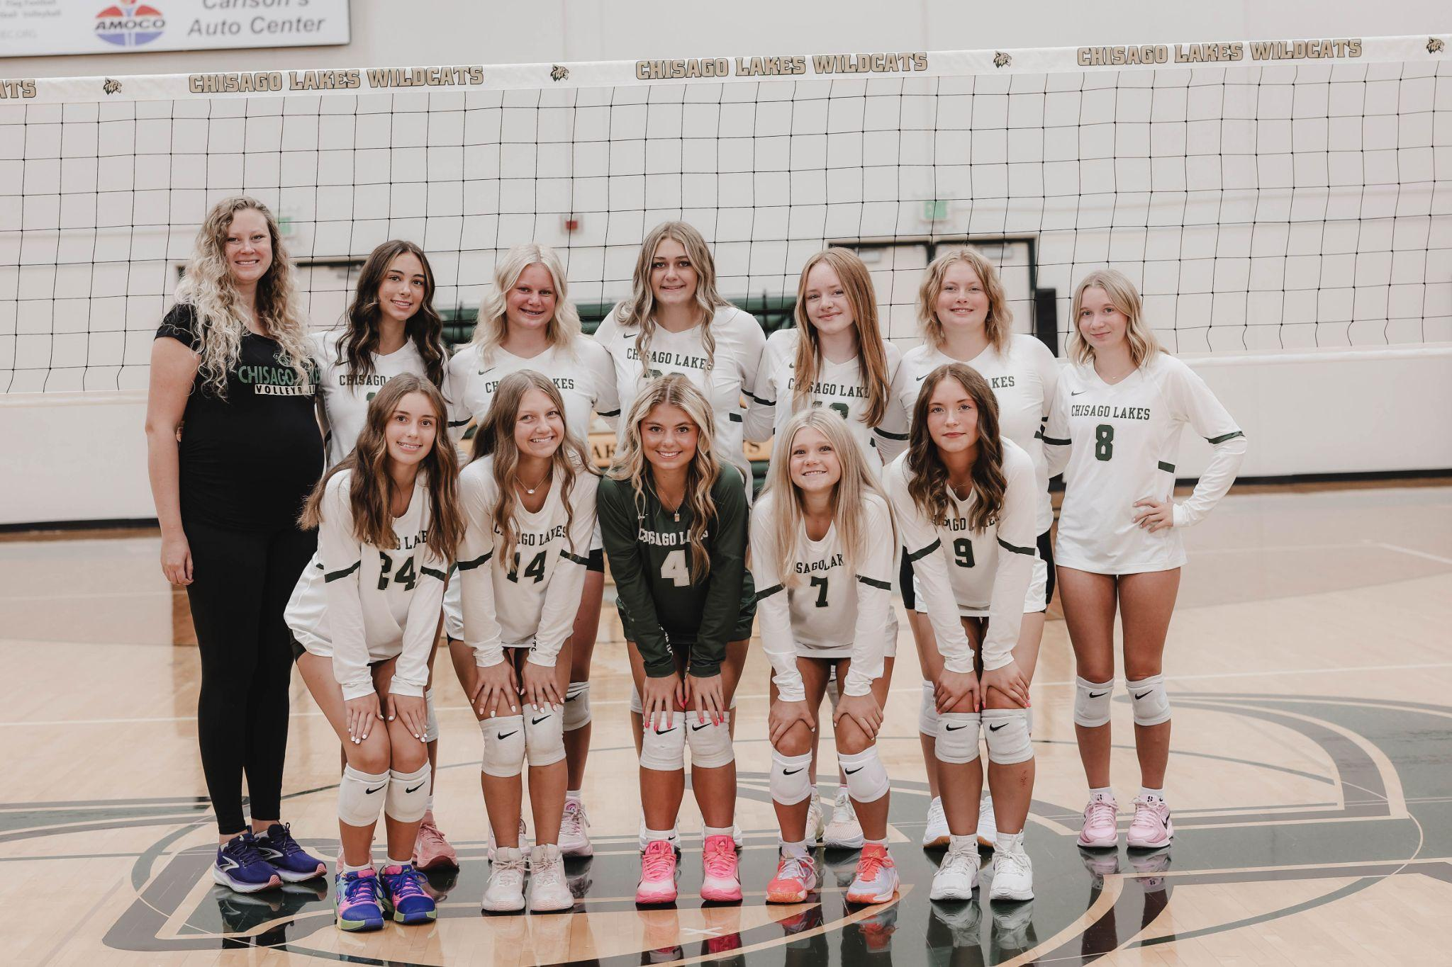
Junior Varsity Team

Slide 18
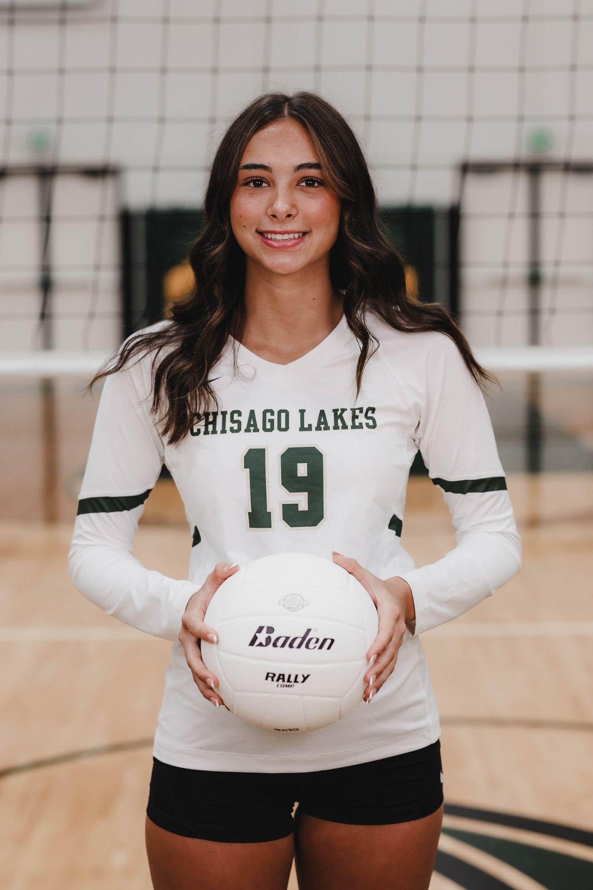
Best Offensive Player:
Piper Chenal

Slide 19
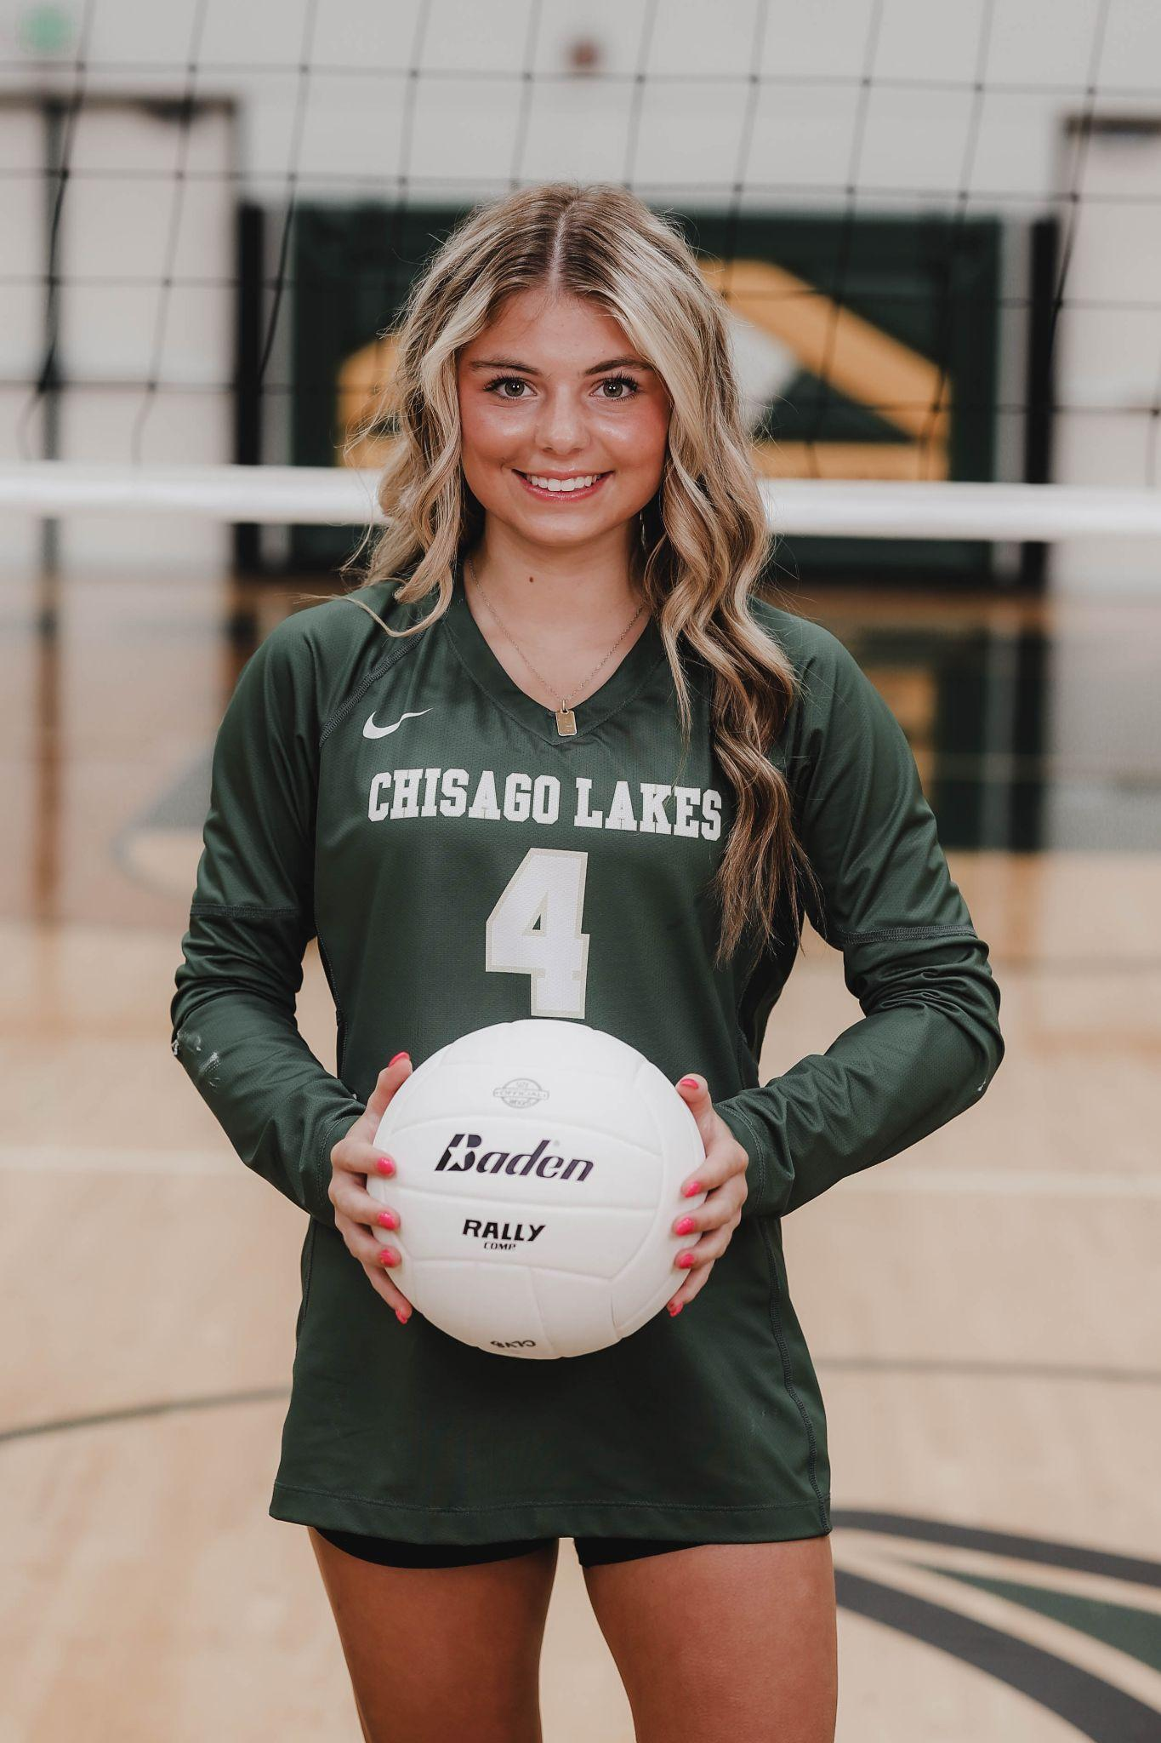
Best Defensive Player:
Ella Hageman

Slide 20
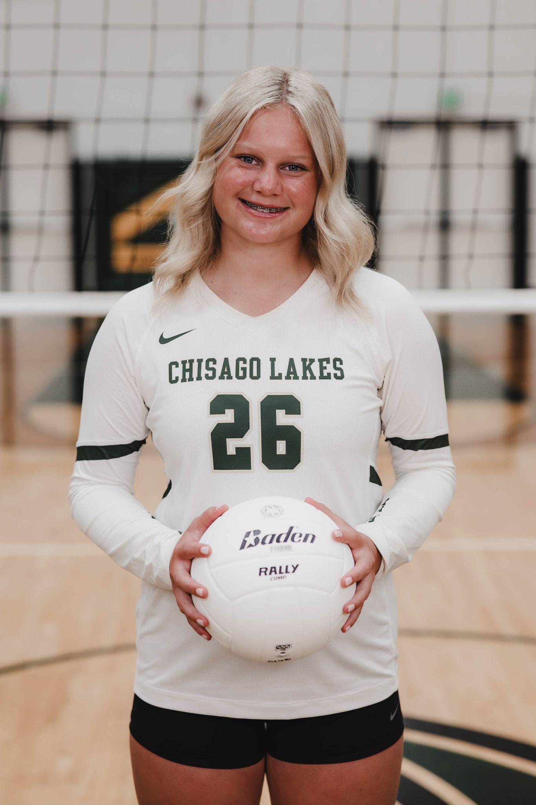
Most Valuable Player:
Audrey Weinzetl

Slide 21
Wildcat Award:
Ella Hageman

Slide 22
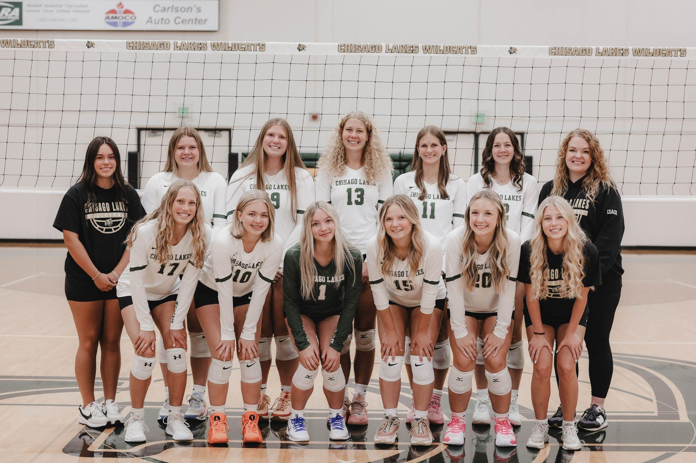
Varsity Team

Slide 23
Varsity Letter Awards:
Kayla Larsen
Kate Friedner
Mariah Cave
Morgan Mayer
Isabel Benolken
Eliana Taylor
Linnea Carlson
Nora Wiger
Kianna Osmundson
Olivia Anderson
Jazlyn Anderson
Ella Hageman
Piper Chenal
Calliegh McDowell
Aubrey Perry
Mikenna Fritzke
Kylie Sowka
Audrey Weinzetl
Ali Bird
Jessica Dittel-Hoefler
Alexa Crowley
Addison Warden

Slide 24
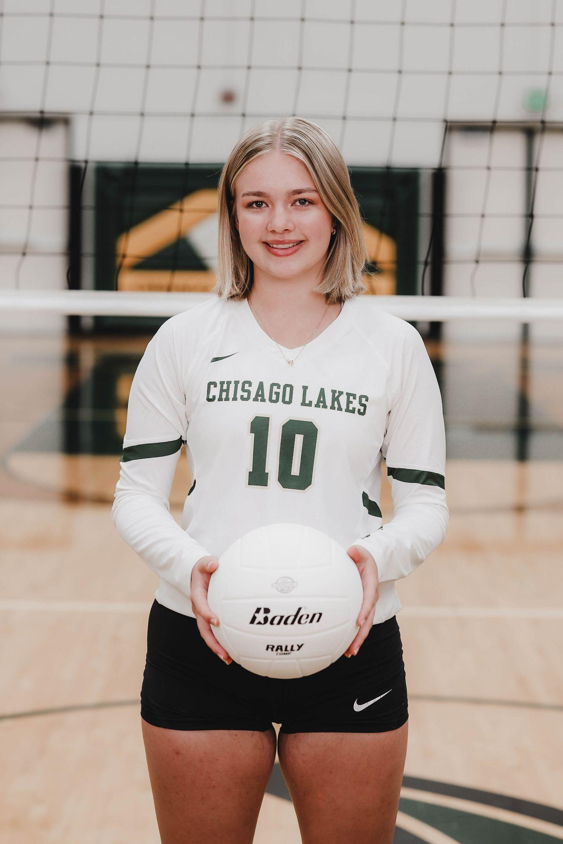
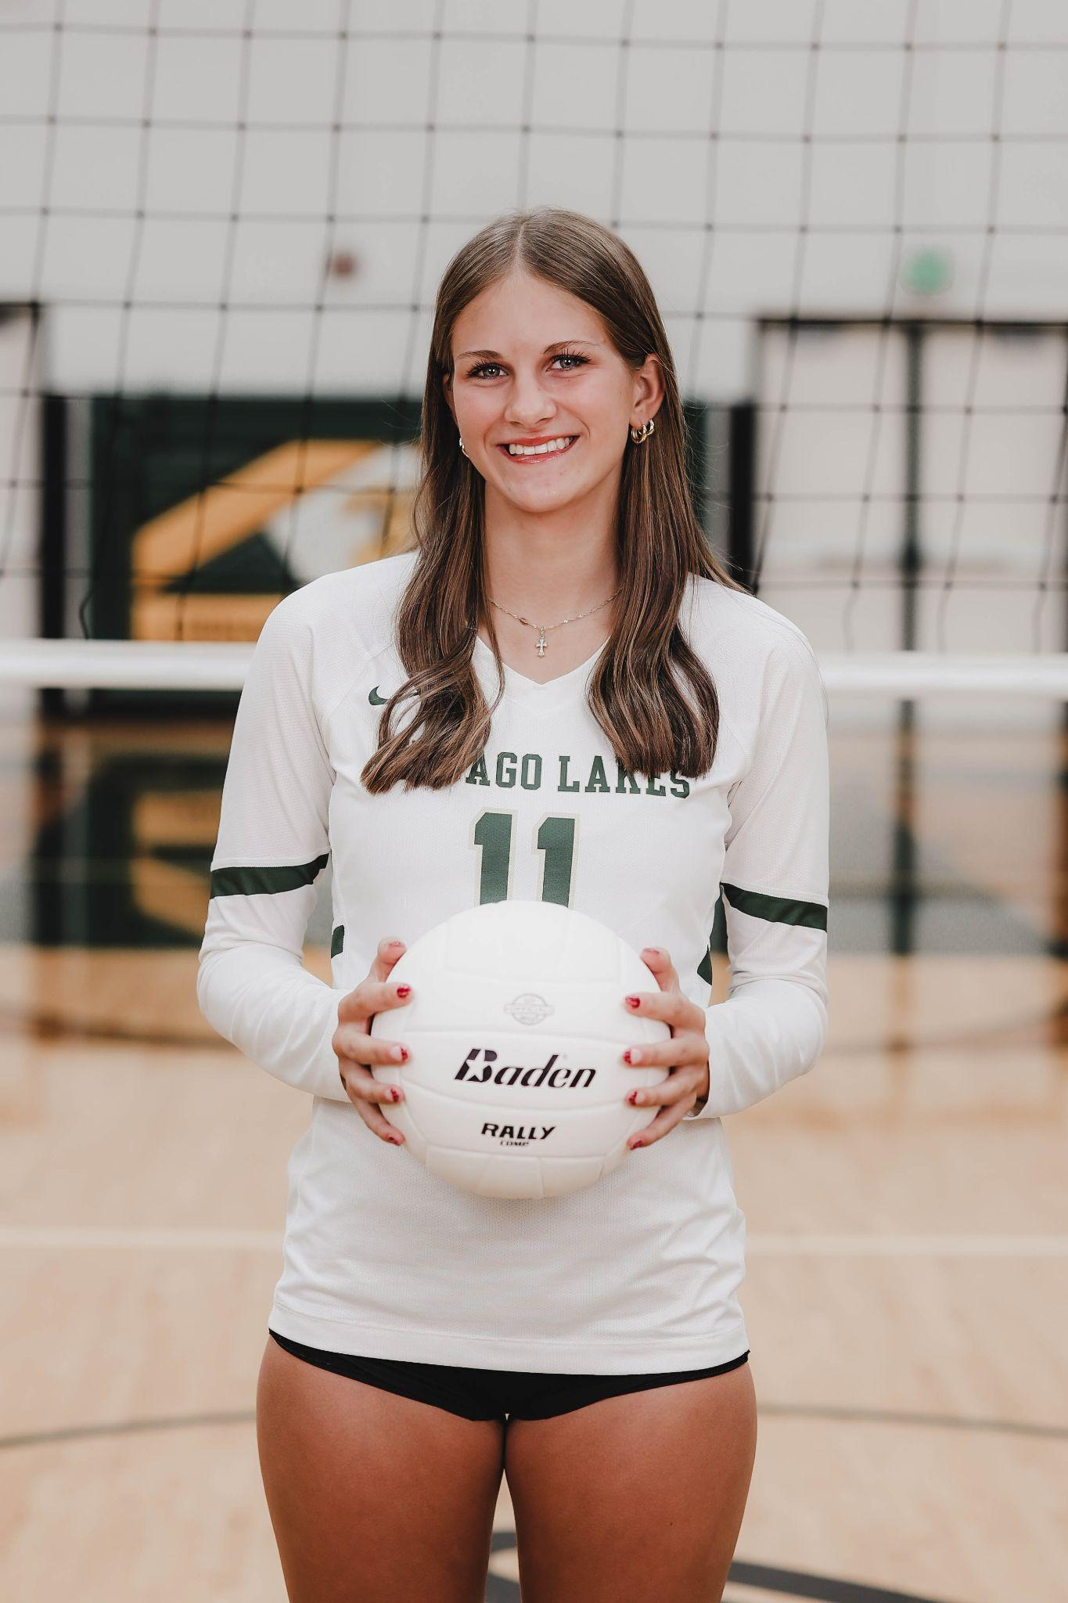
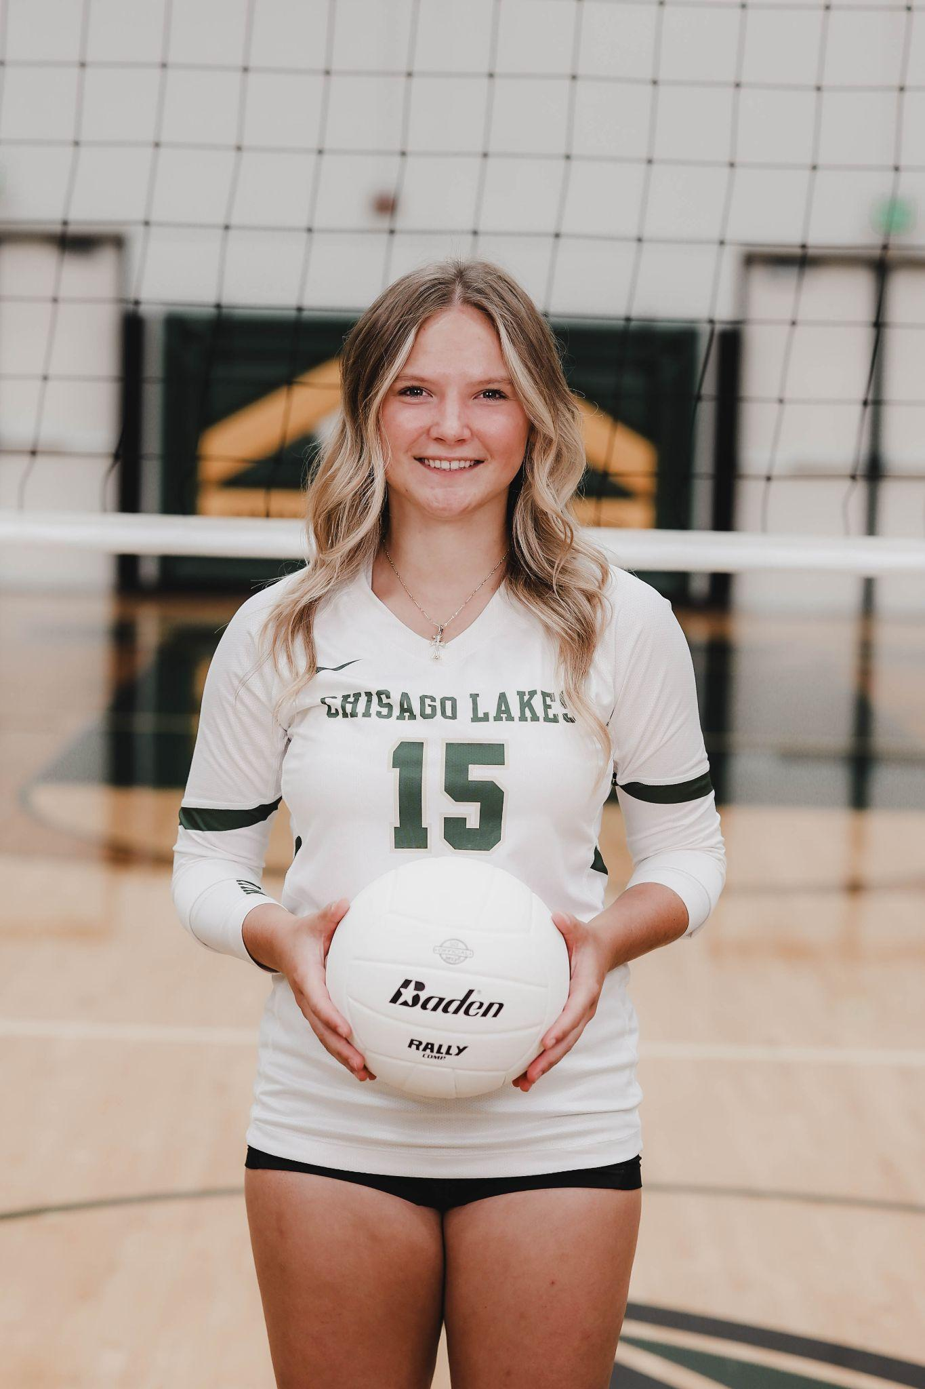
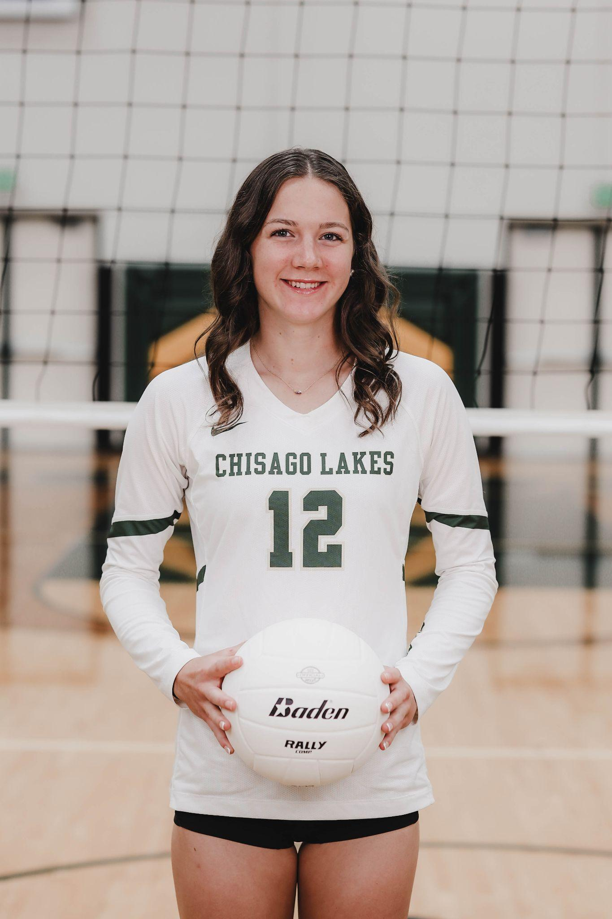
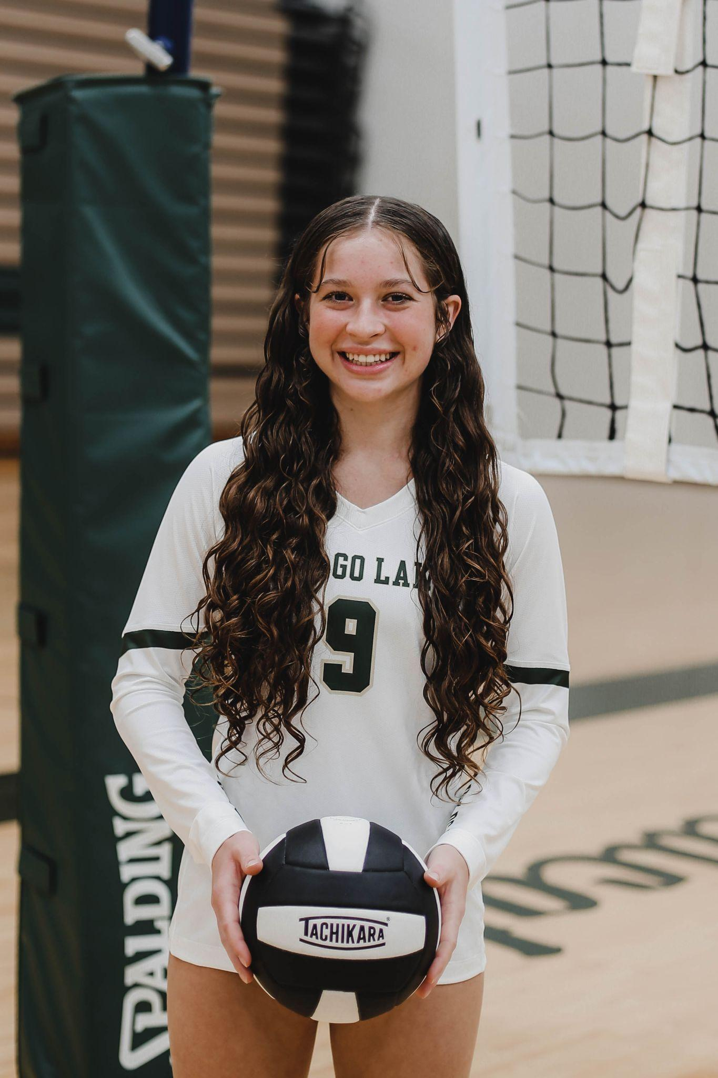
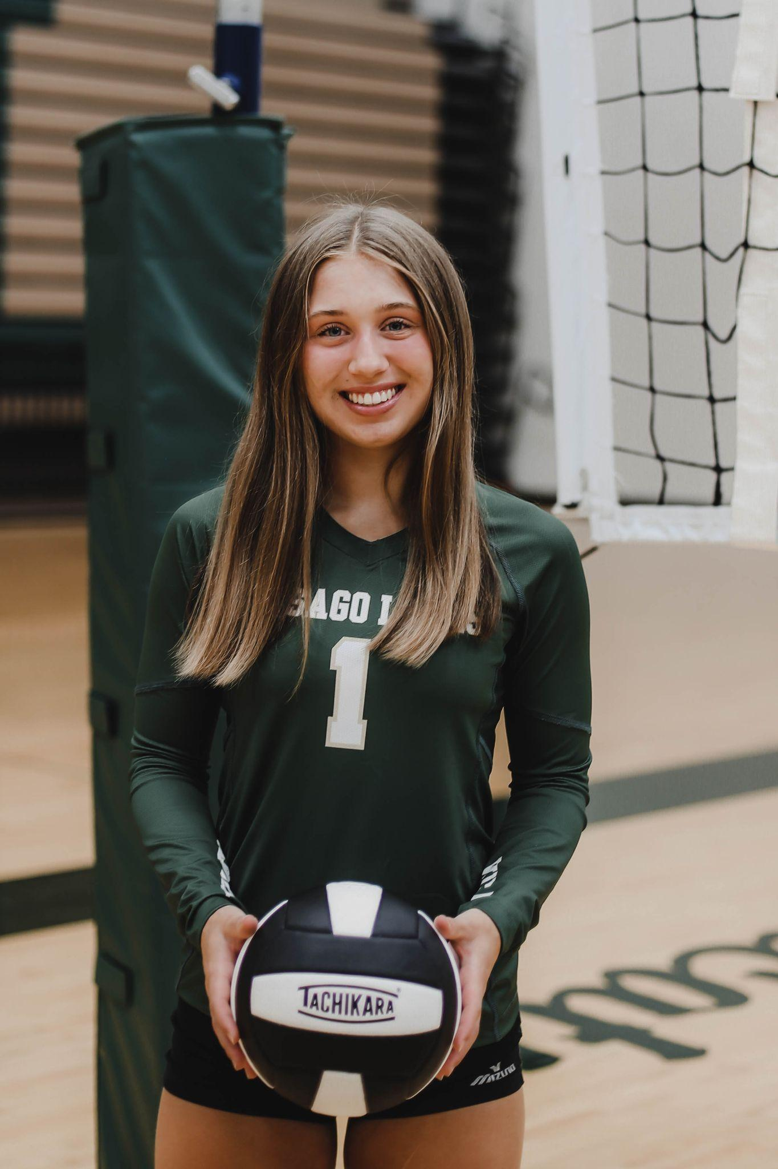
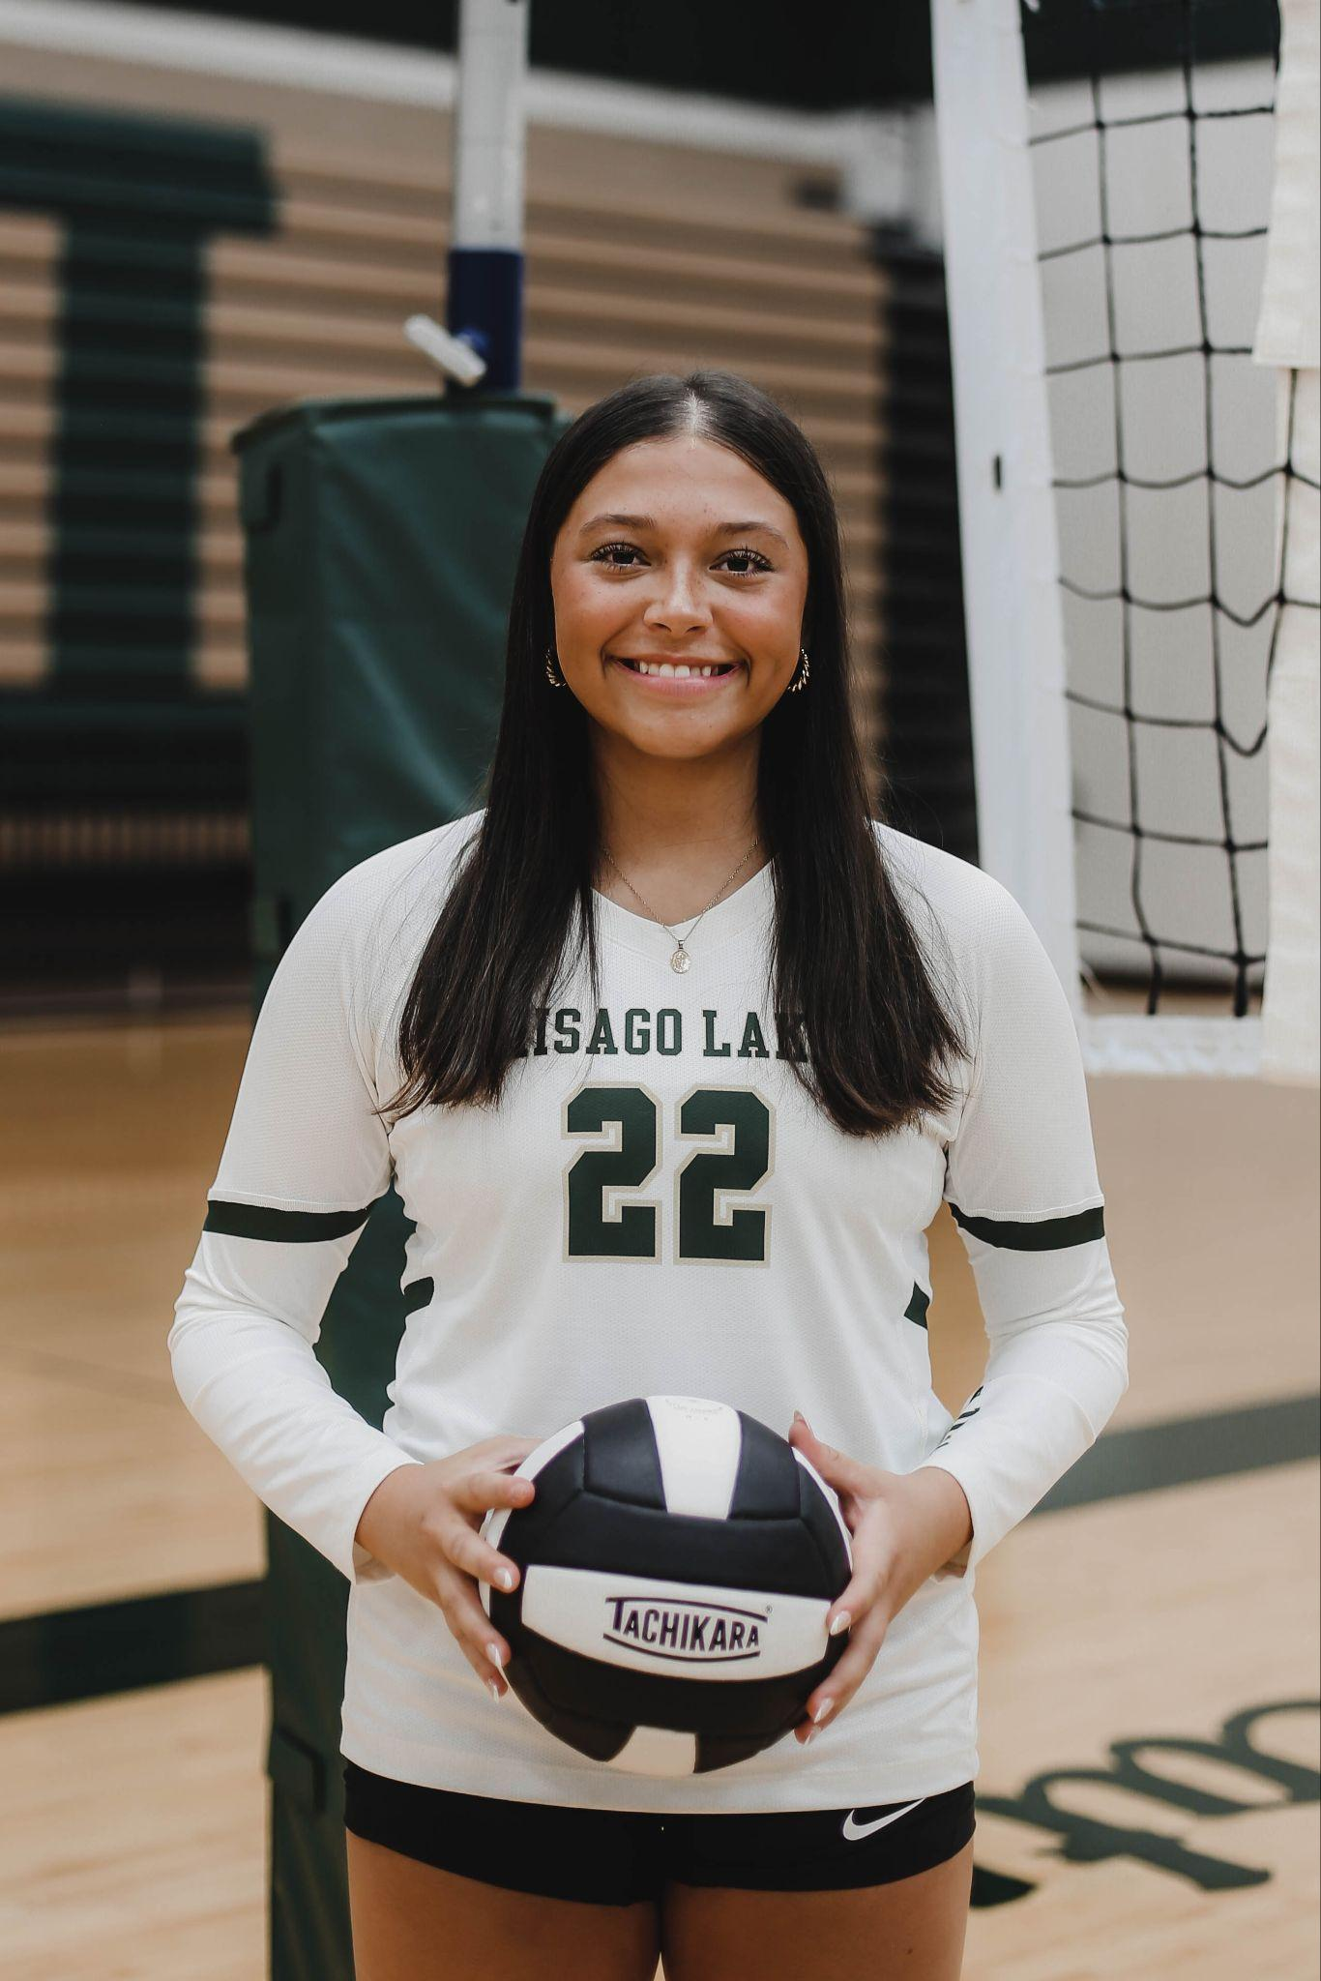
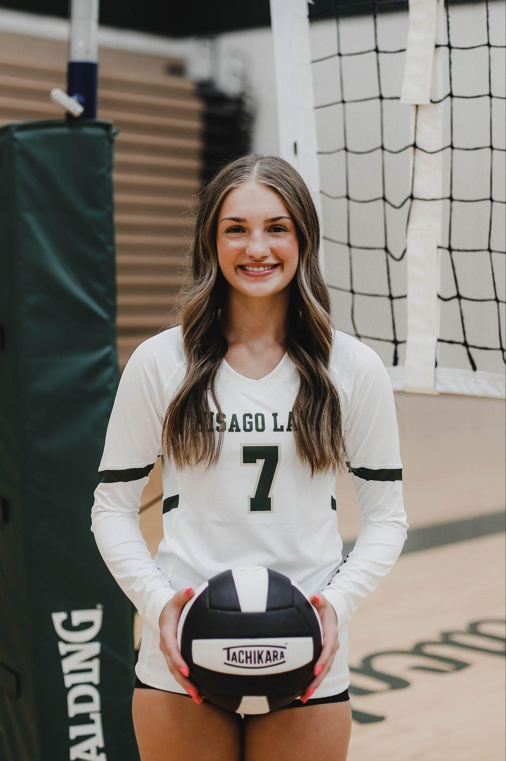
Senior Activity Award:
Isabel Benolken Kate Friedner Morgan Mayer Kayla Larsen
Notes:
Seniors who played all 4 years

Slide 25
Academic All-State Award:
Kayla Larsen
Notes:
Academic All-State awards are for seniors on the team roster that have a 3.80 cumulative grade point average over the course of their high school career.

Slide 26
Mississippi 8 All-Conference Academic Award:
GOLD AWARD
Notes:
3.61!
> 3.5 GPA

Slide 27
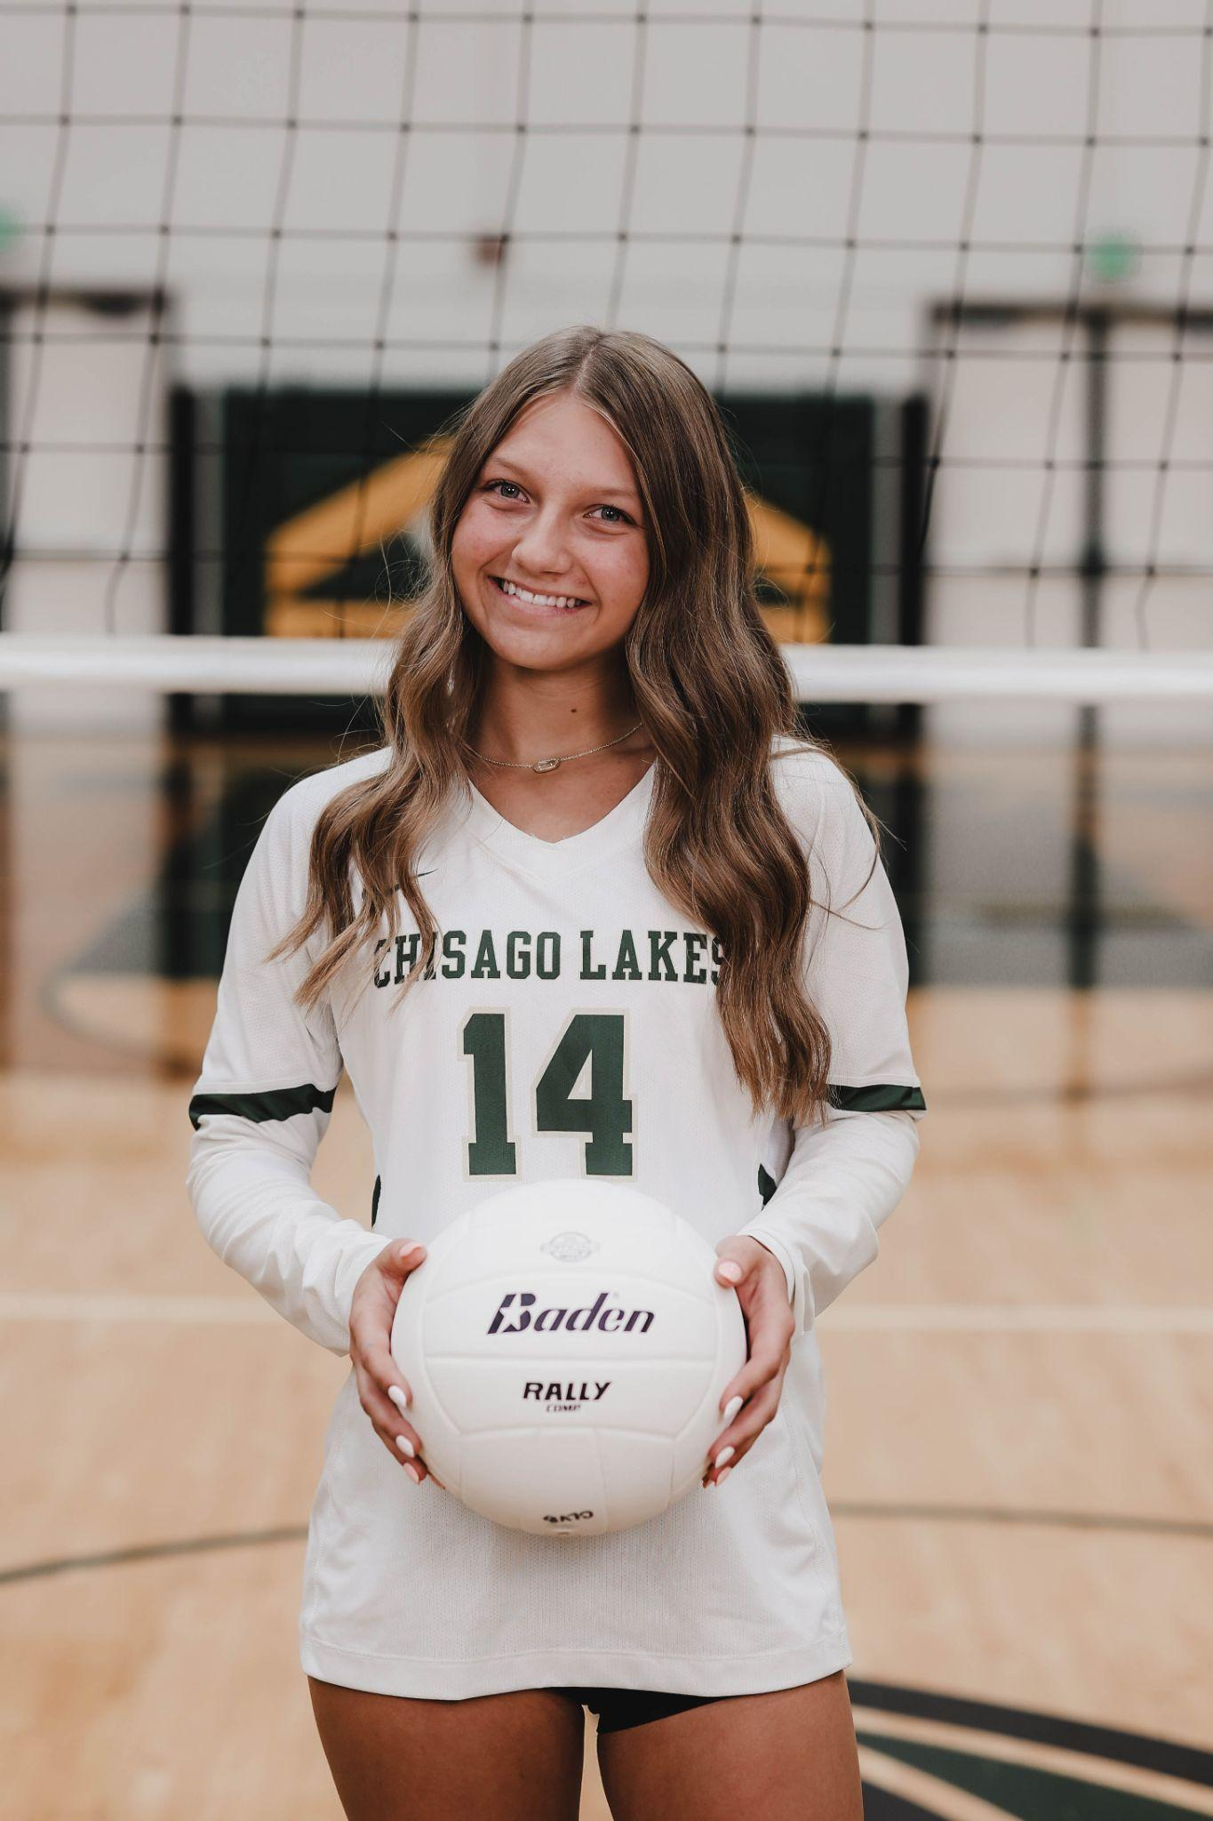
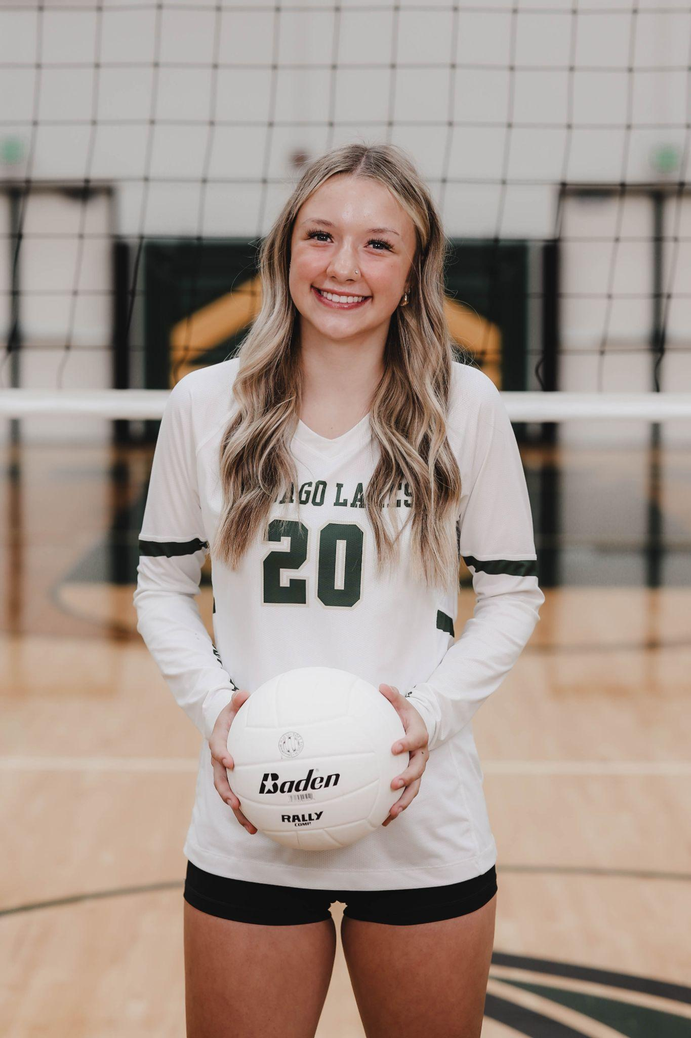
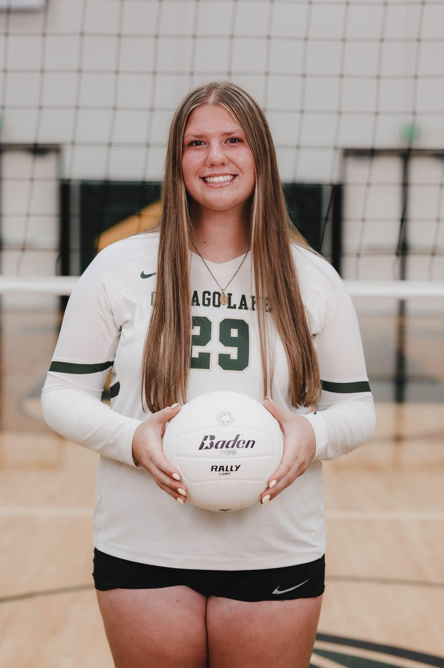
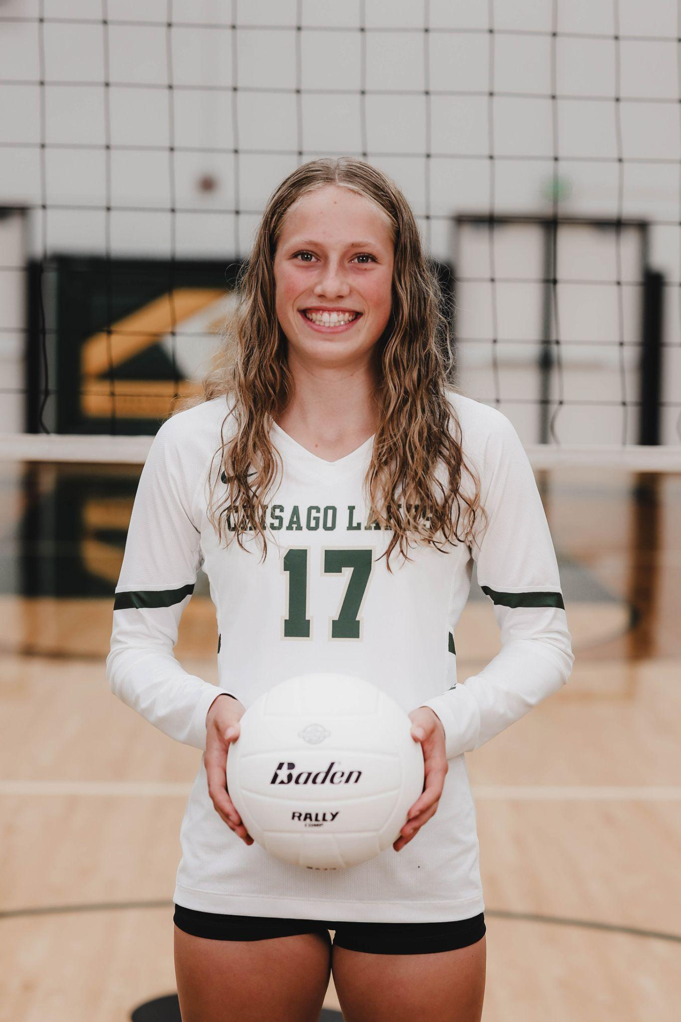
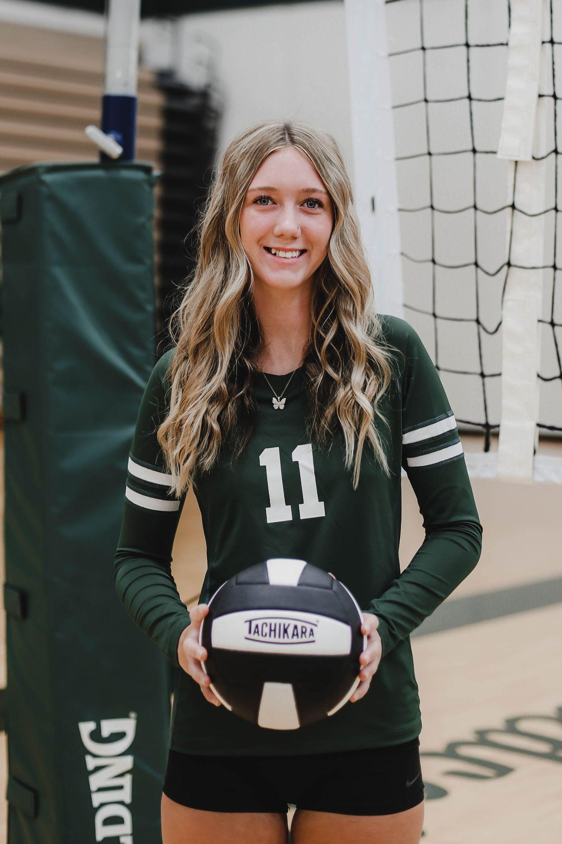
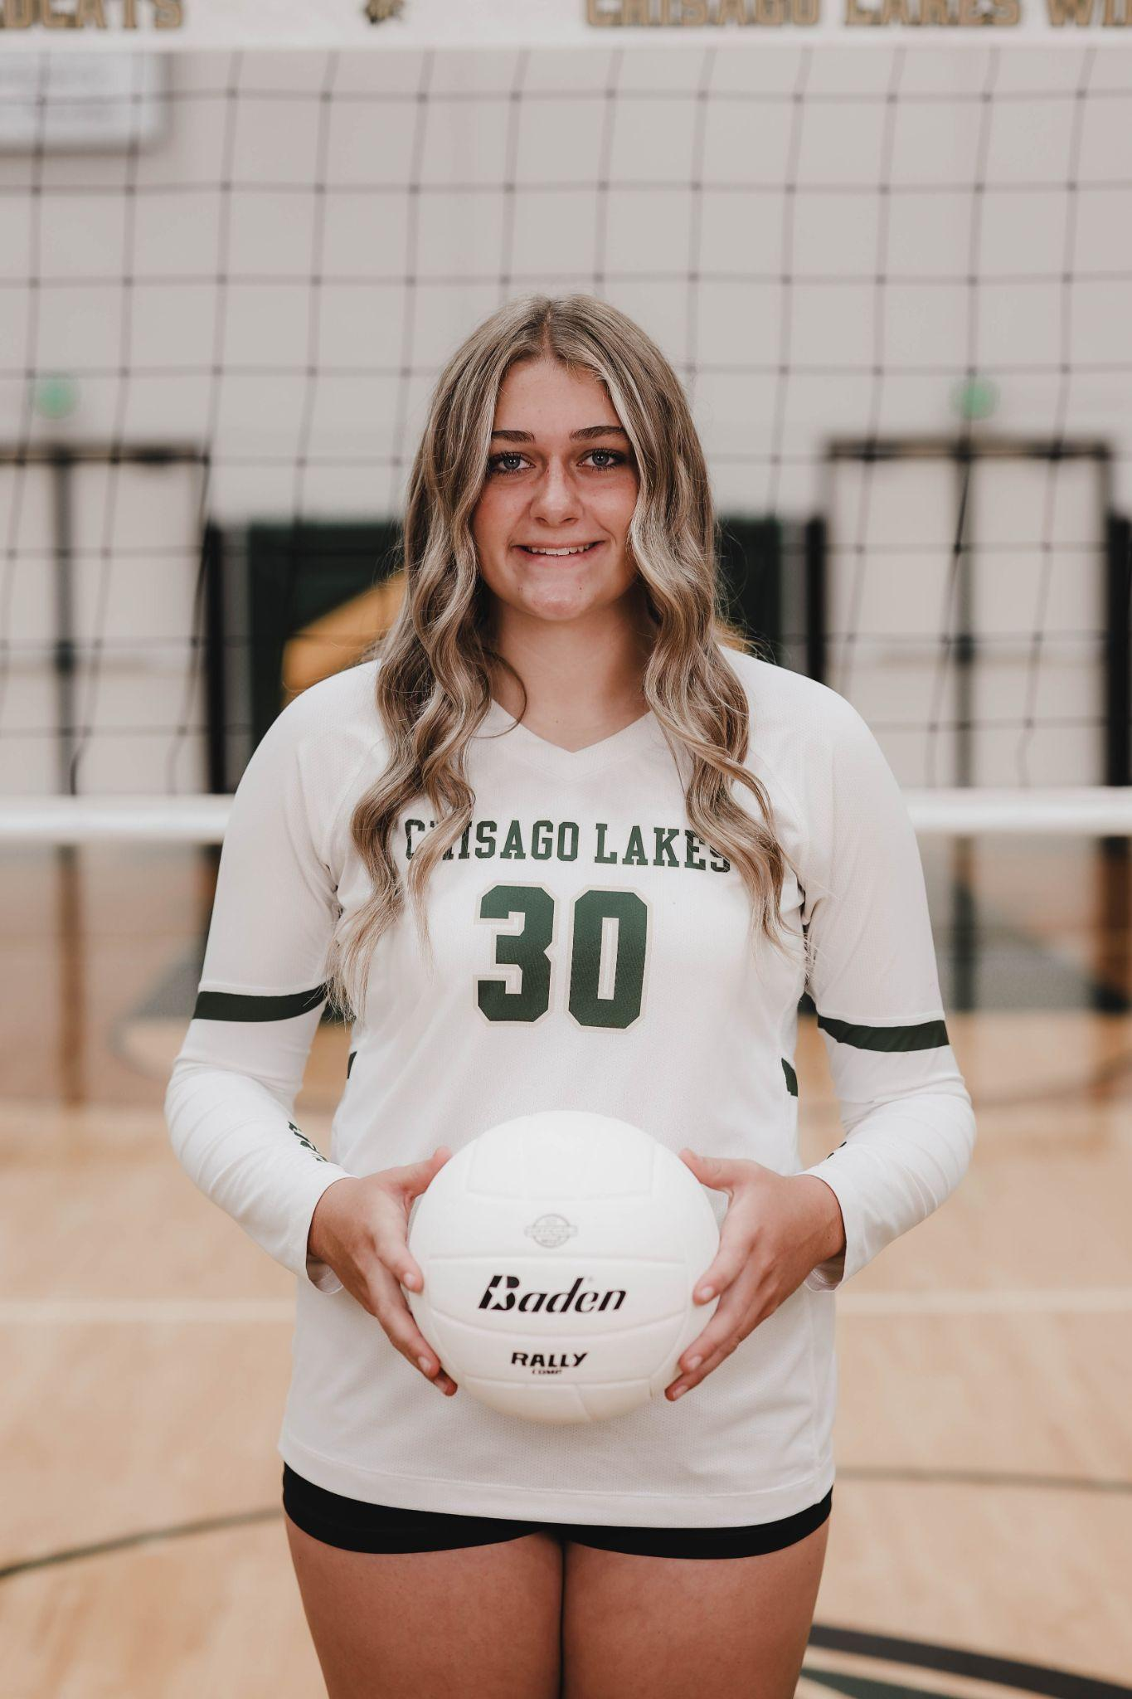
All-Conference Academic Team:
Kayla Larsen Jazlyn Anderson Piper Chenal Nora Wiger Linnea Carlson Kianna Osmundson Mikenna Fritzke Aubrey Perry
Notes:
Academic All Conference -
Participate on section roster grades 10-12
Cumulative GPA of 3.7 or higher
Freshmen are not eligible in the fall as they don't have a GPA

Slide 28
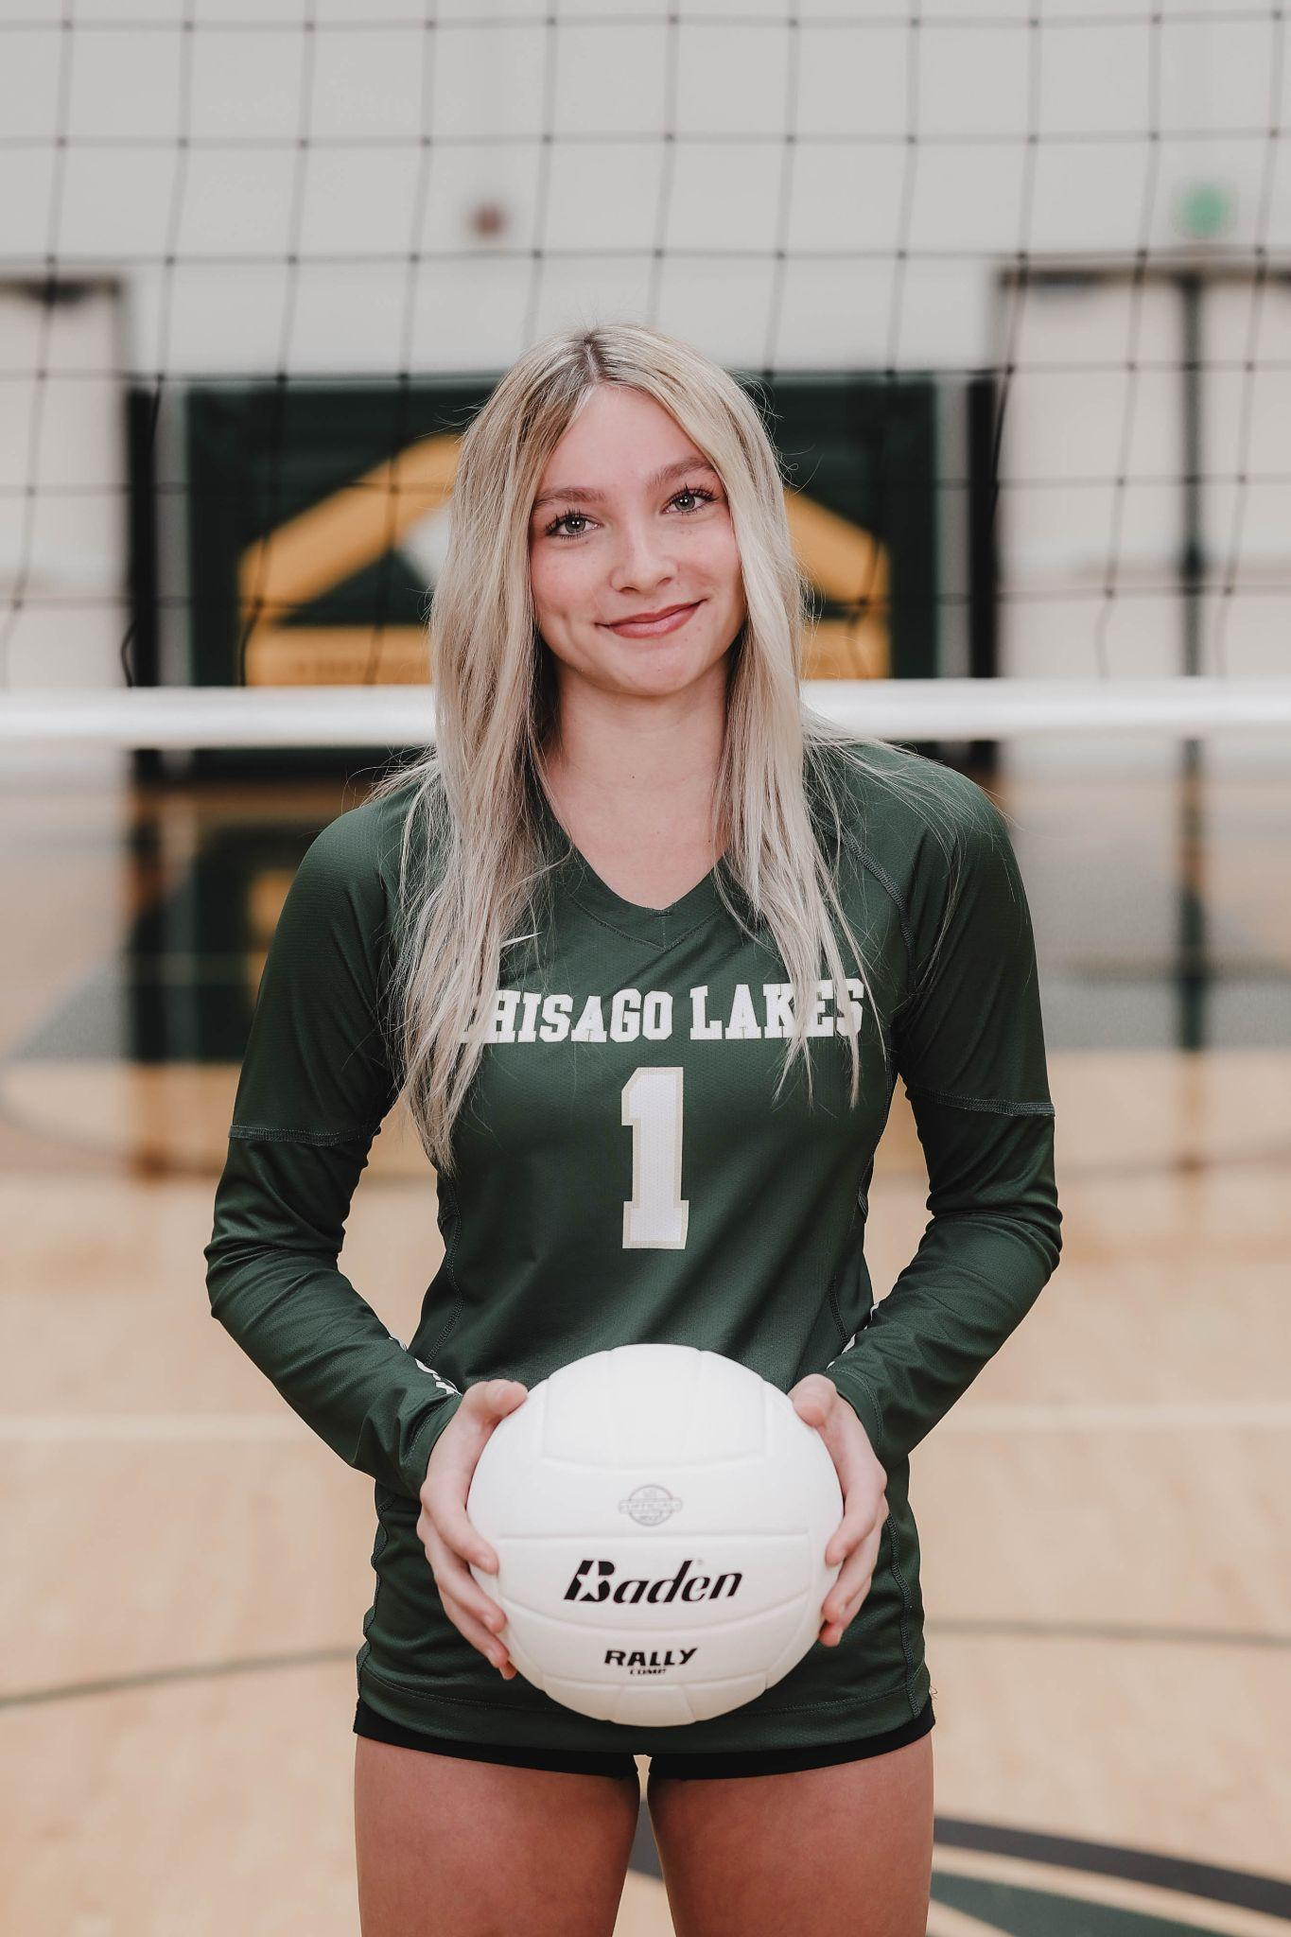
All-Conference Awards:
Mississippi 8 All-Conference Honorable Mention 2025
Kayla Larsen
Olivia Anderson

Slide 29
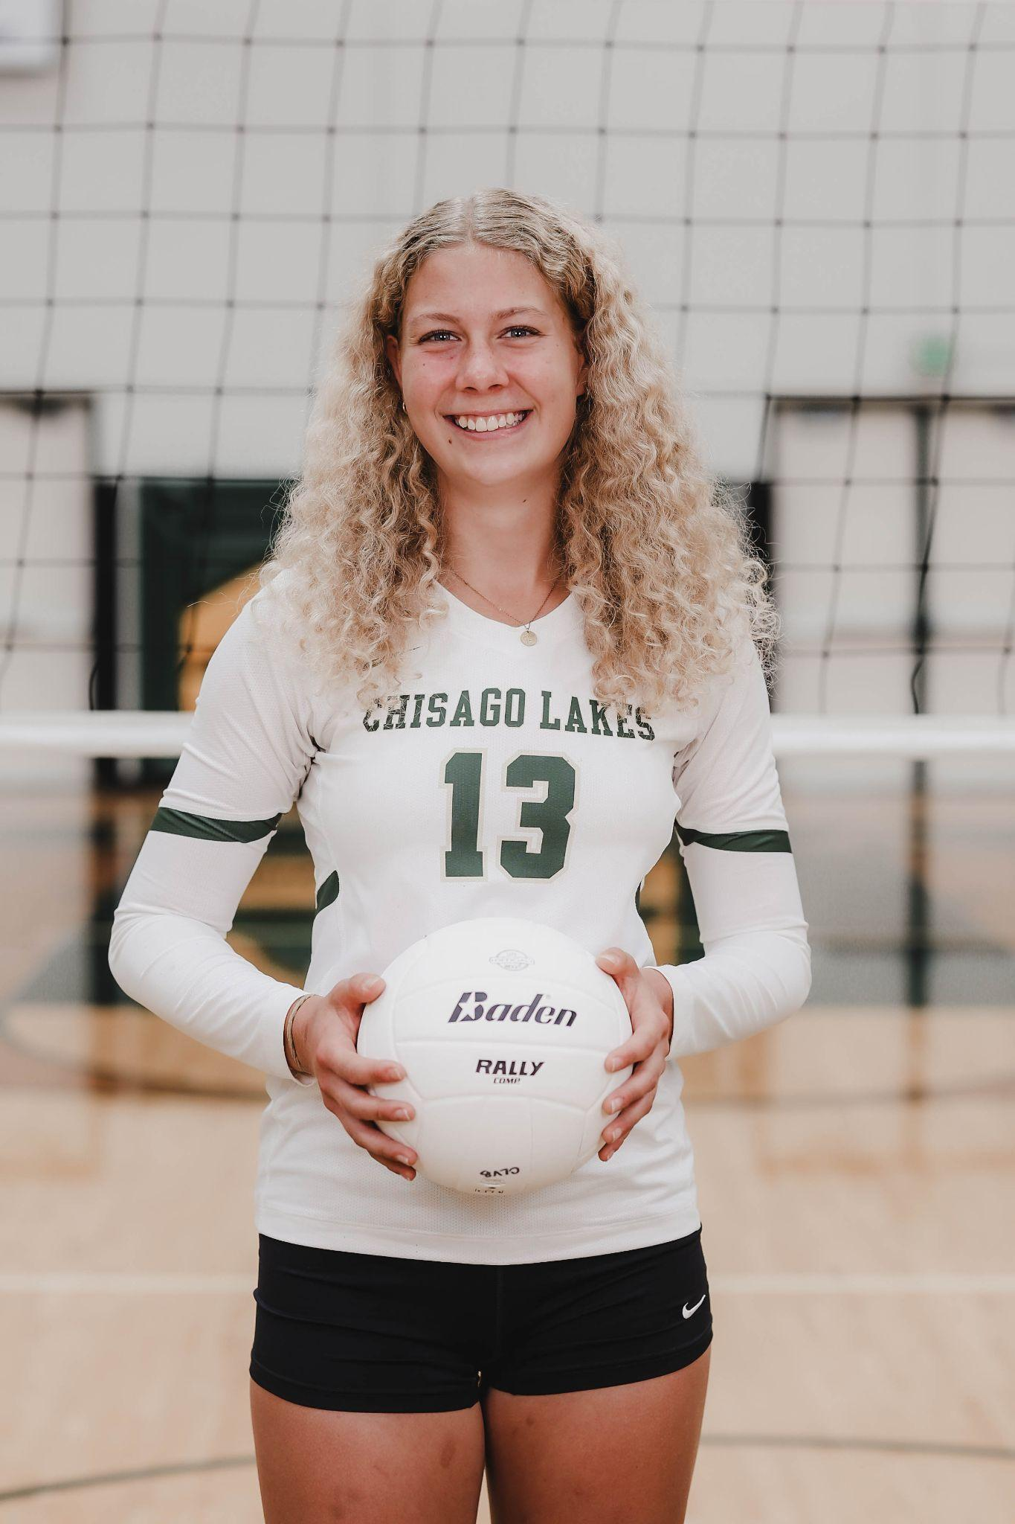
All-Conference Awards:
Mississippi 8 All Conference 2025
Kate Friedner
Mariah Cave

Slide 30
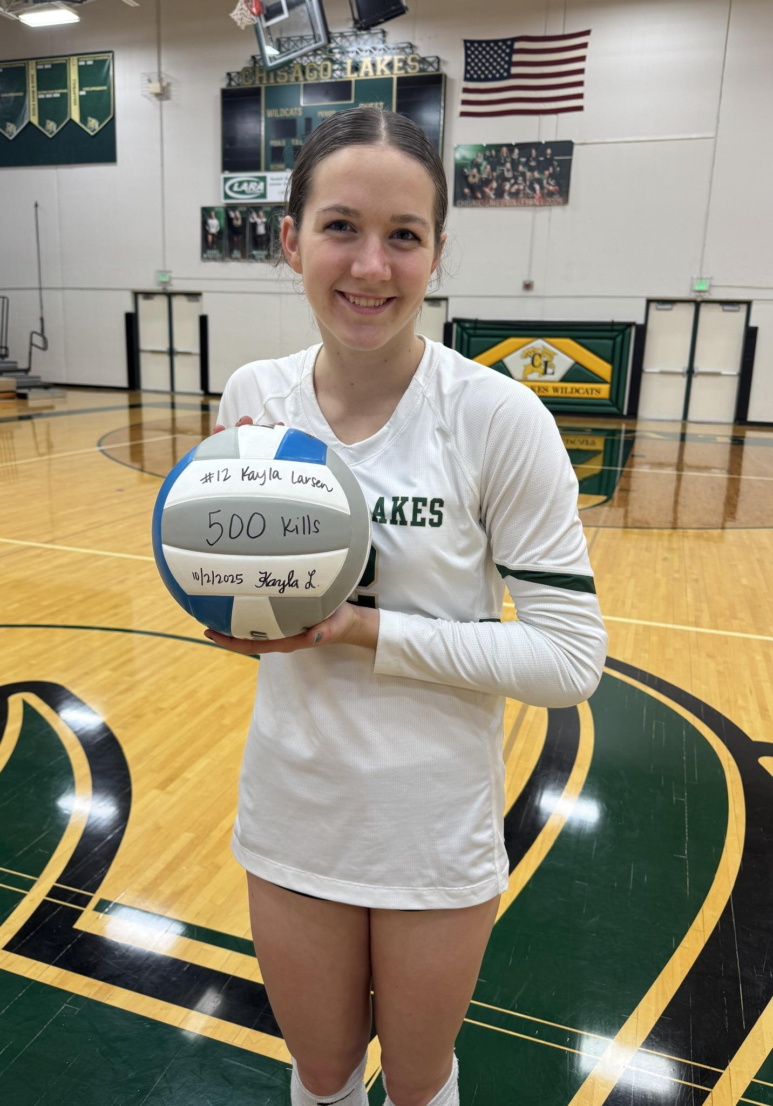
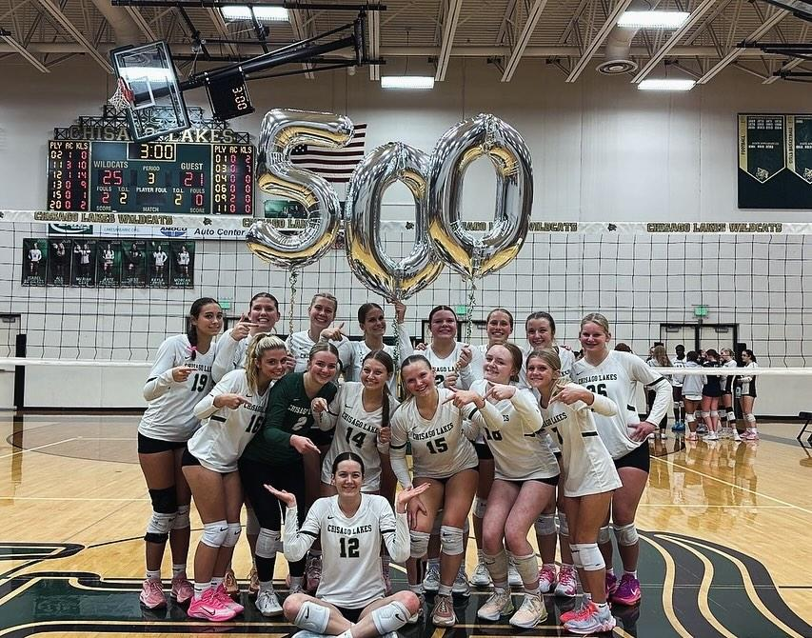
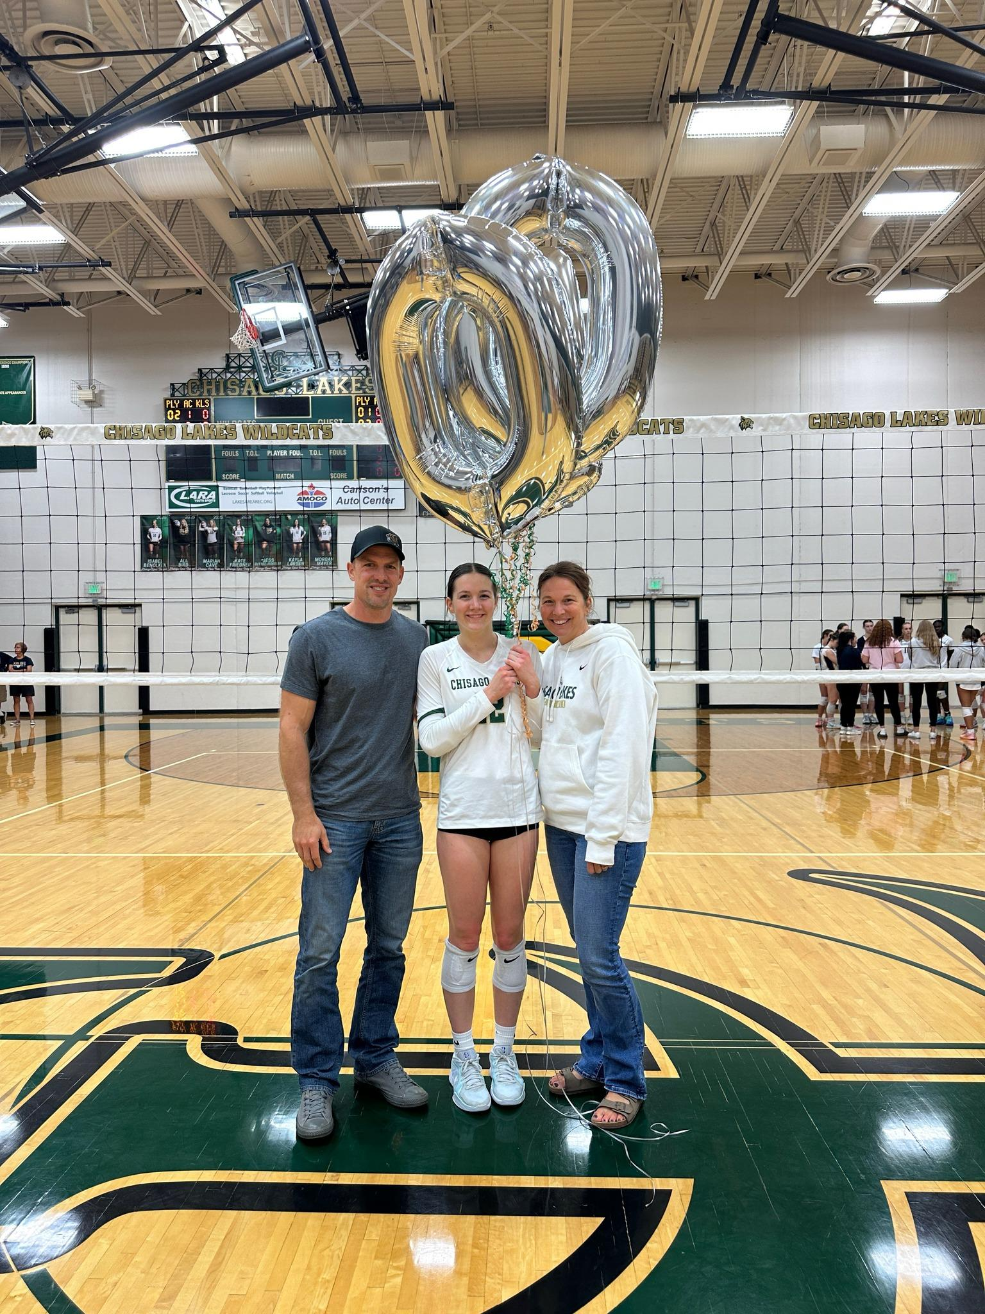
Stat Milestone
500 Career Kills
Kayla Larsen

Slide 31
Best Offensive Player Award:
Mariah Cave

Slide 32
Best Defensive Player Award:
Olivia Anderson

Slide 33
Most Valuable Player Award:
Kate Friedner

Slide 34
Wildcat Award:
Kianna Osmundson

Slide 35
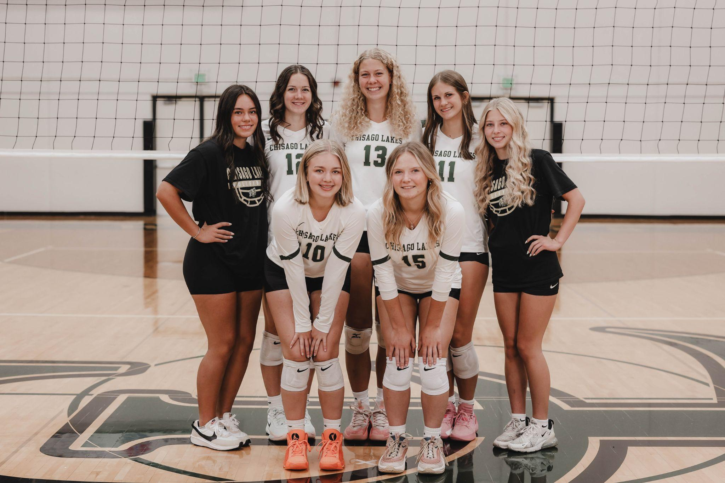
Senior Recognition

Slide 36
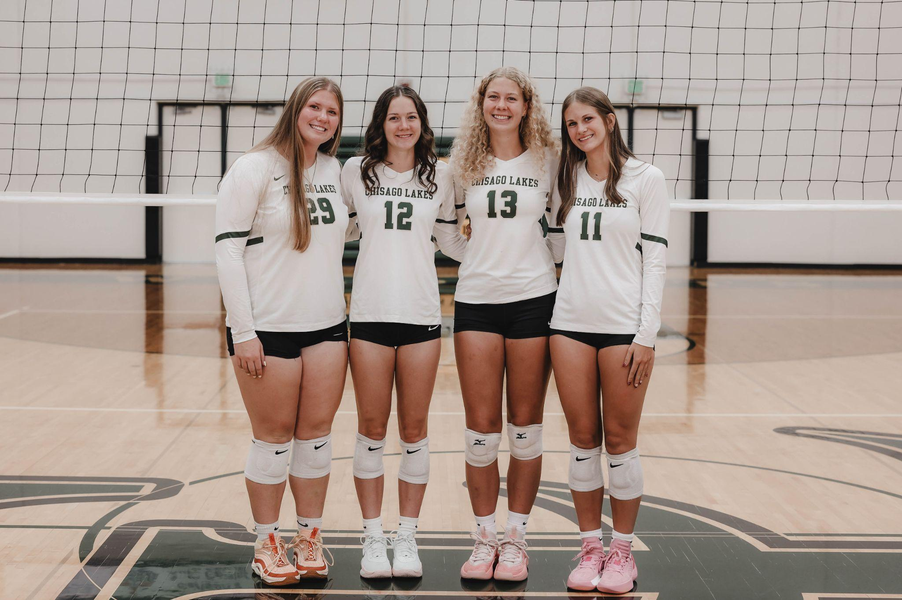
Captain Recognition

Slide 37
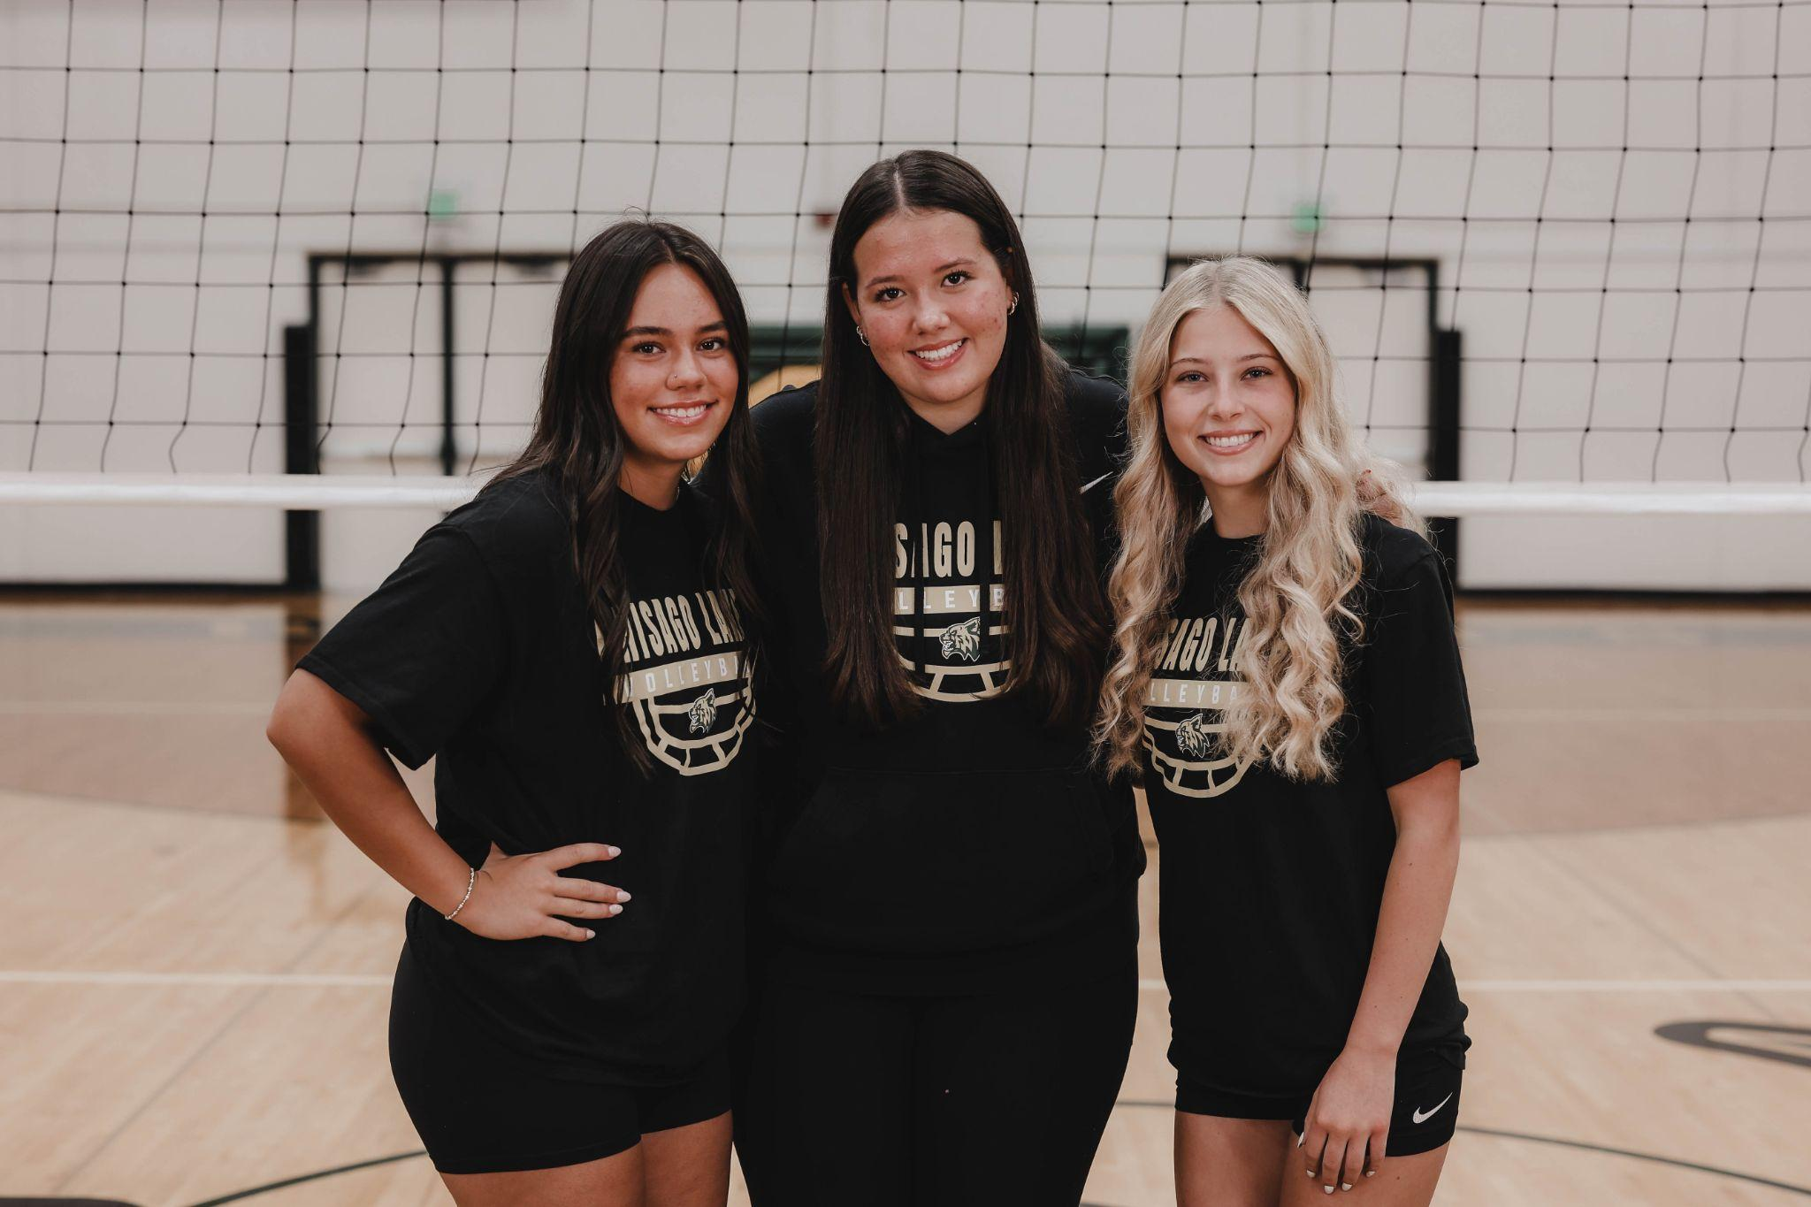
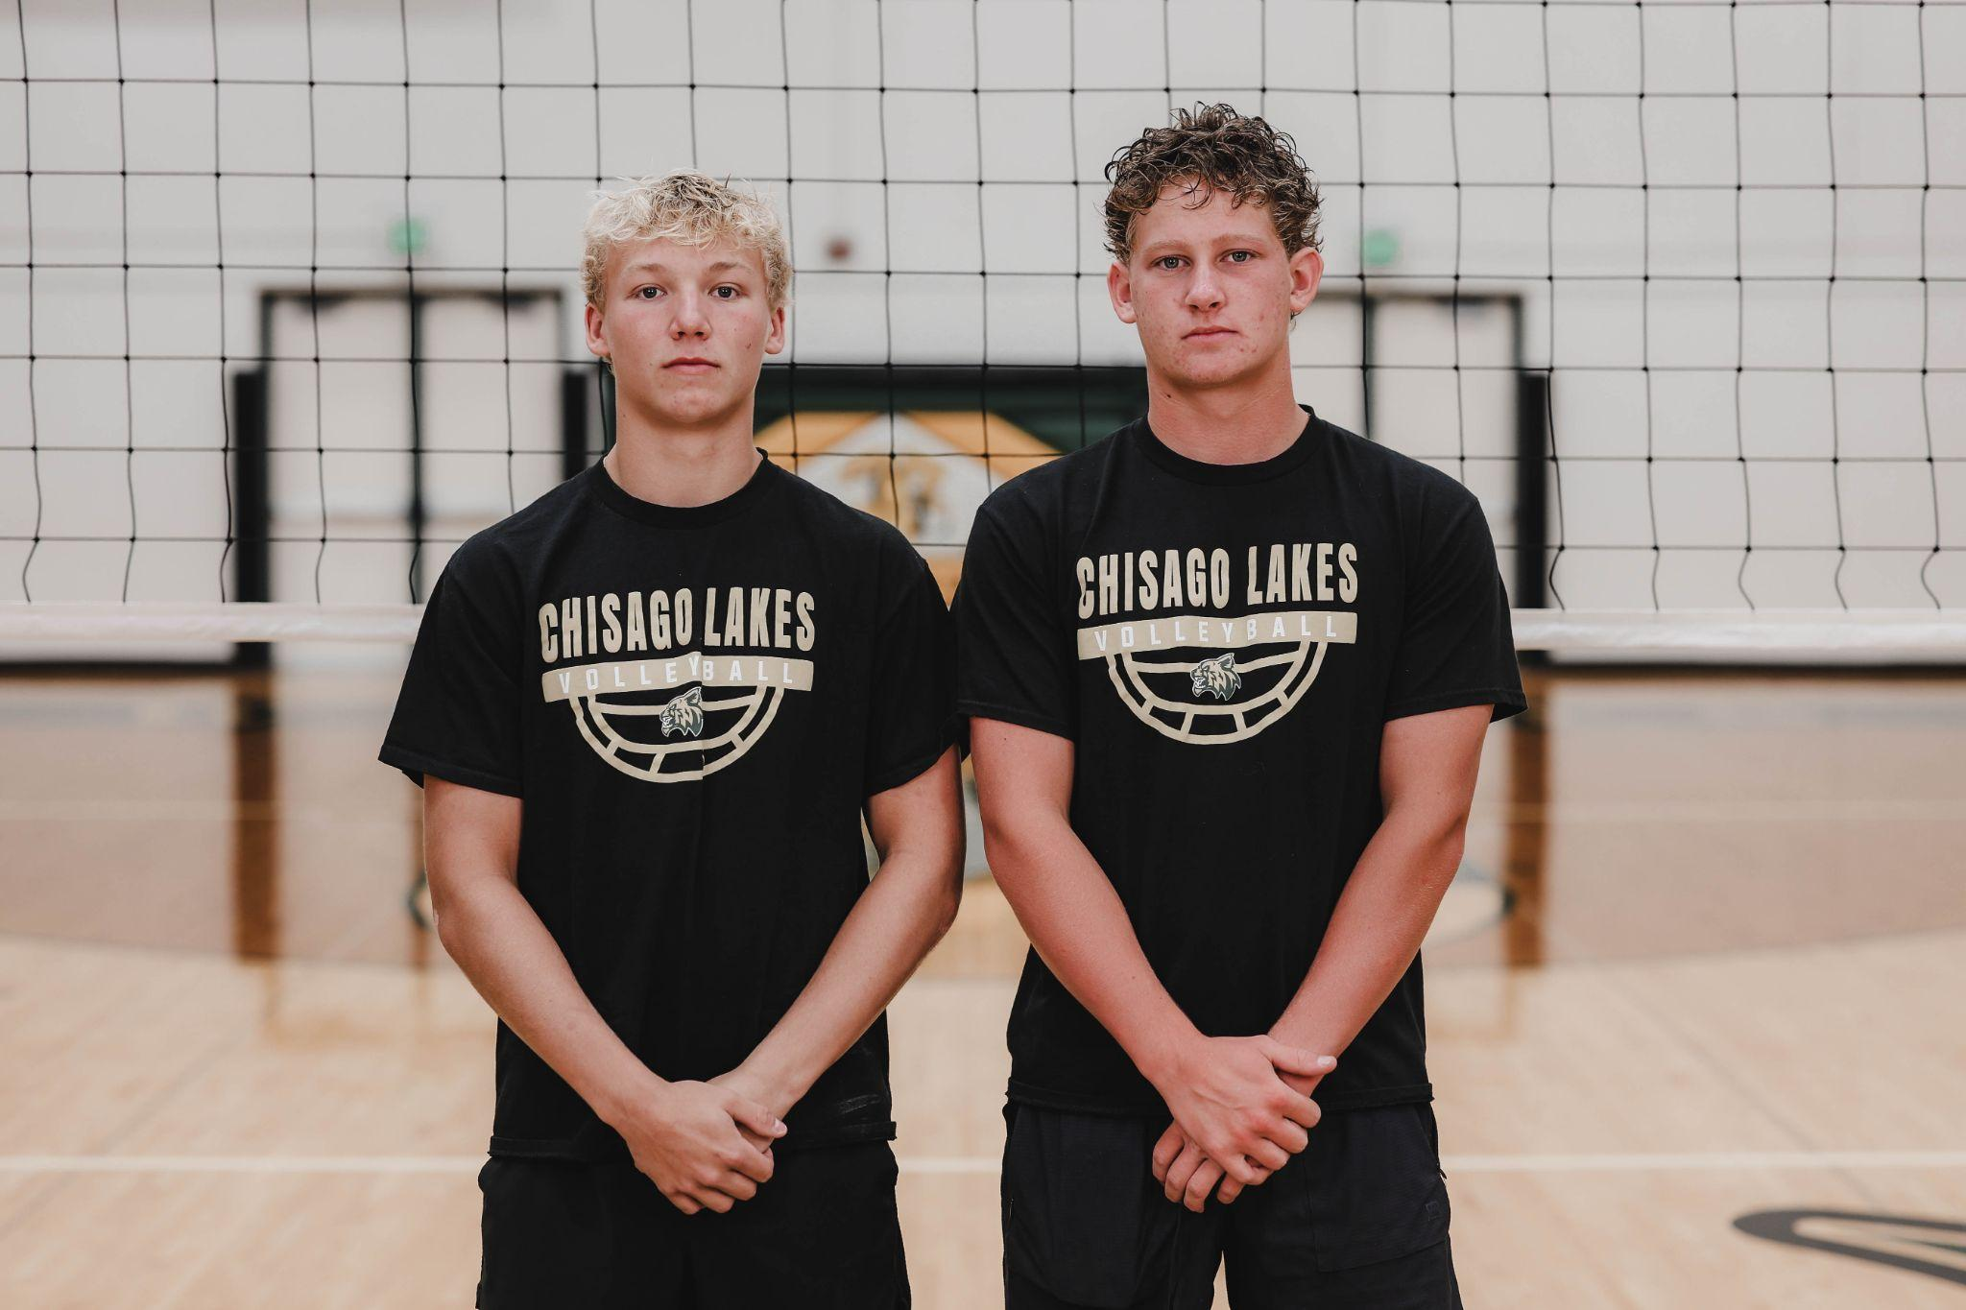
Manager Recognition

Slide 38
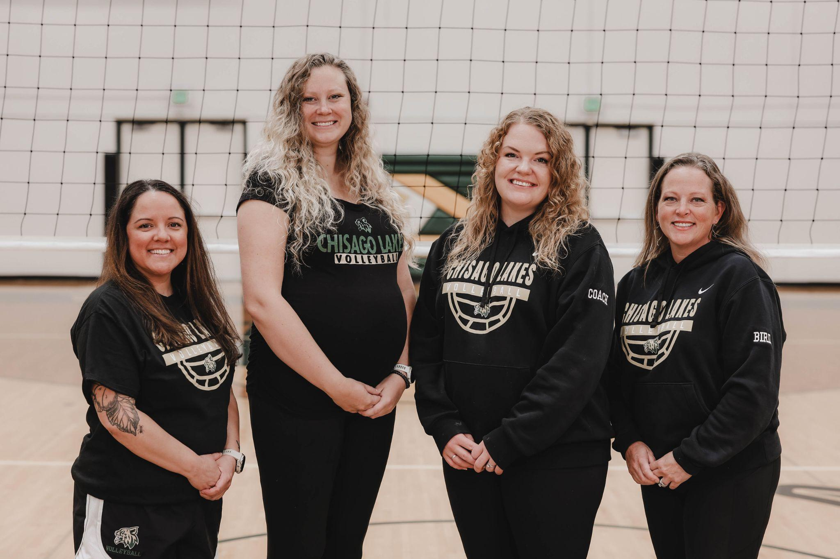
Coach Recognition:
Coach Carlson
Coach Nicole
Coach Avery
Coach Katie
Coach Vince
Coach Shannon

Slide 39
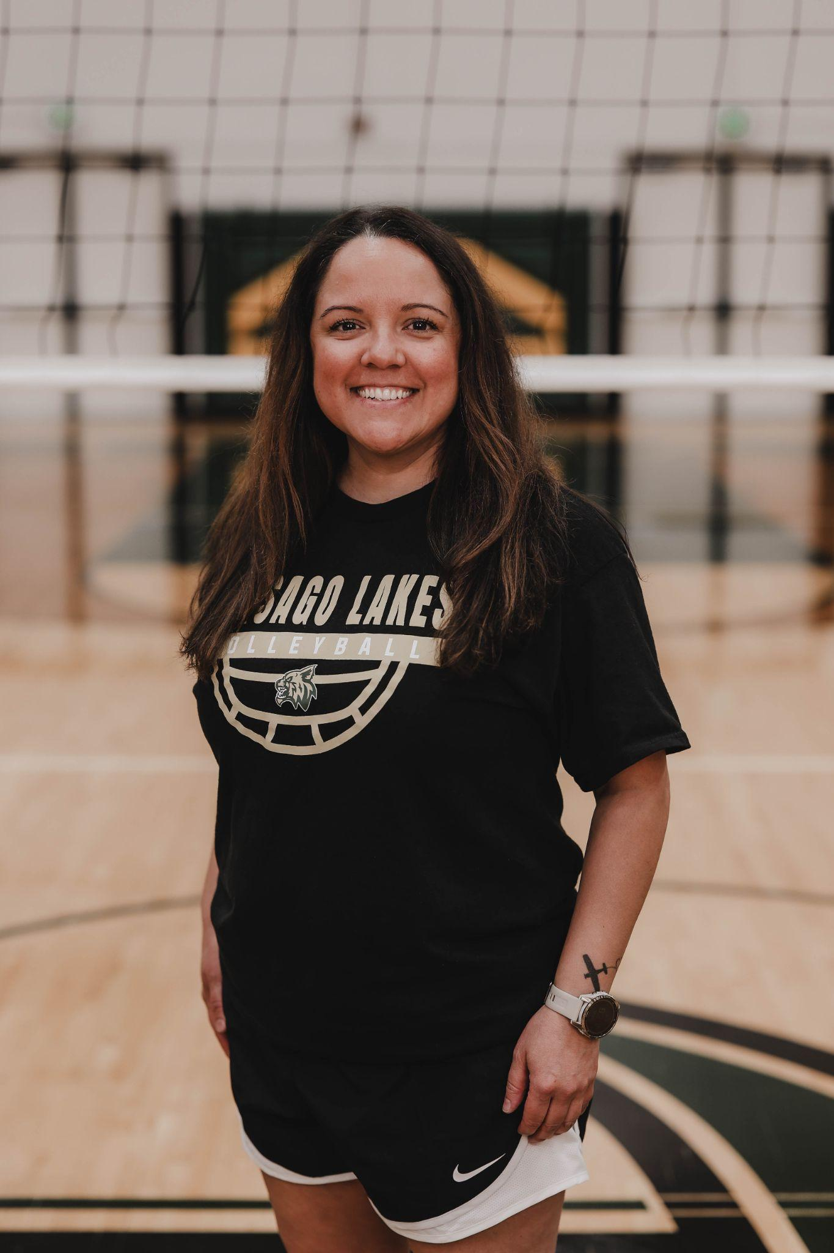
MNVBCA Jeff Groves Outstanding Assistant Coach Award:
Coach Katie

Slide 40

Parent Recognition

Slide 41
2025 Team Award:
Compete
"Strive to gain or win something by defeating or establishing superiority over others."

Slide 42
Upcoming Dates:
Spring Highway Cleanup
TBD
Summer Camp Series
Current 5th-11th
Tues & Thurs, 8-10am
June 19- July 24
Summer Camp Week
HS: 8-11am
July 27-30
Season Starts
August 17
Join Remind for updates!
Text @clvb2025 to 81010

Slide 43
279 days until 2025 season!

